Slide 1
London Boroughs Recycling Scorecard 2026
London’s recycling rate (the proportion of waste sent for recycling or composting) dropped from 32.7% to 32.6%, the lowest rate since 2016.
Since 2020, the rate has dropped by 0.9% points.
London’s recycling rate remains the second lowest in England, after the North East with 31.1%.
The South West remains the best performing region with a rate of 49.4%, up 0.5% points since last year.

Slide 2
London Boroughs Recycling Scorecard 2026 - Borough comparisons
The top four performing boroughs with highest total recycling rate remain the same as last year, although Bromley and Ealing saw slight decreases in their rates, and Bexley an increase.
Brent’s large jump up the rankings puts it back to near where it was in the 2024 scorecard, making last year appear to be something of an anomaly.
Bromley’s rate dipped just below the 50% milestone which it was the first London borough to achieve last year.
Tower Hamlets saw an increase of 1.2% points but remains the lowest performing borough by some distance.
Ealing, Bexley, Kingston, Richmond and Sutton are the next best performing boroughs, all with a rate of over 40%.
Wandsworth climbed out of the bottom four with an impressive increase of 5.1% points.
Hammersmith & Fulham, Islington, Newham, and Westminster also saw increases of more than 2% points.
Croydon had the biggest decrease of 3.5% points.
11 boroughs have a recycling rate of less than 30%, down from 13 last year
Wandsworth and Brent’s increases were the second and third largest seen in England, after Cornwall (see Annex Table 1).
Five other boroughs were among the top 20 biggest increases in England (Islington, Hammersmith & Fulham, Newham, Westminster and Bexley), compared with only two last year.
However, in common with last year, there are no London boroughs in the top 20 local authorities with the highest recycling rates in England, see Annex Table 2.

Slide 3
London Boroughs Recycling Scorecard 2026
2025 London Boroughs Recycling Scorecard: boroughs with highest and lowest recycling rates

Slide 4
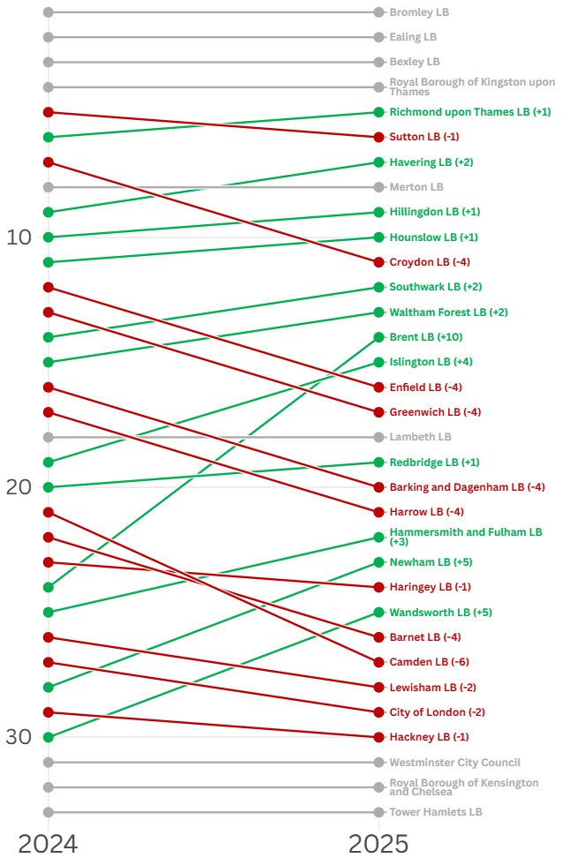
London Boroughs Recycling Scorecard 2026
Change in rank order of boroughs on recycling scorecard between 2024 and 2025

Slide 5
London Boroughs Recycling Scorecard 2026

Slide 6
London Boroughs Recycling Scorecard 2026 - Amount of waste collected per person
This is the total amount of waste collected per person regardless of whether it was sent for recycling, composting or disposal. The lowest rate was 201kg per person in Ealing and the highest 406kg in Westminster.
Nine of the 20 English local authorities with the lowest kg of household waste collected per person are London boroughs, including all of the six lowest. This is unchanged from last year, see Annex Table 3.
City of London and Islington were the English local authorities with the largest decrease in waste collected per person over the previous year, with Ealing, Redbridge and Hackney also in the top 20, see Table 4.

Slide 7
London Boroughs Recycling Scorecard

Slide 8
London Boroughs Recycling Scorecard 2026

Slide 9
London Boroughs Recycling Scorecard 2026

Slide 10
London Boroughs Recycling Scorecard 2026

Slide 11
London Boroughs Recycling Scorecard 2026

Slide 12
London Boroughs Recycling Scorecard 2026
ANNEX TABLE 5 – London Boroughs Household Recycling and Composting Rates, highest to lowest, 2024/25

