Slide 1

Smoke and Mirrors:
Enfield ‘new town’
Carol Fisk, Enfield RoadWatch
enfieldroadwatch.co.uk

Slide 2
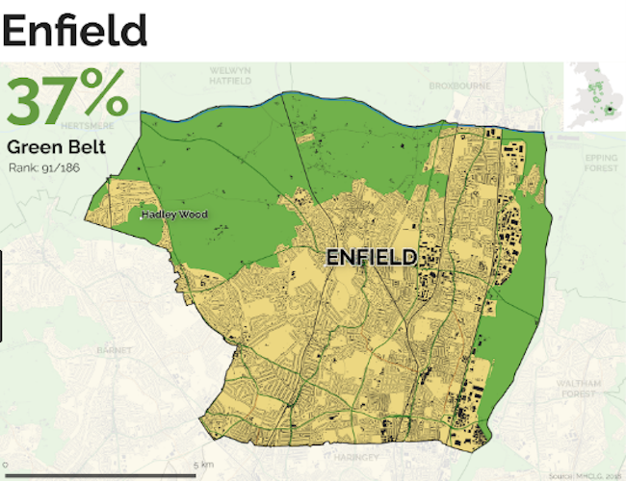

What we’re fighting for
The London Borough of Enfield is about 37% Green Belt.
Much of the Green Belt is owned by the Council and consists of tenanted farms, used mostly for grazing with some arable.
One large farm, Vicarage Farm, is owned by developer, Comer Homes
There are also several parks in the Green Belt.
An extensive area of garden centres, known as Crews Hill, also lies within the Green Belt under permitted horticultural use.
Most of the Green Belt is accessible via a network of footpaths.

Slide 3
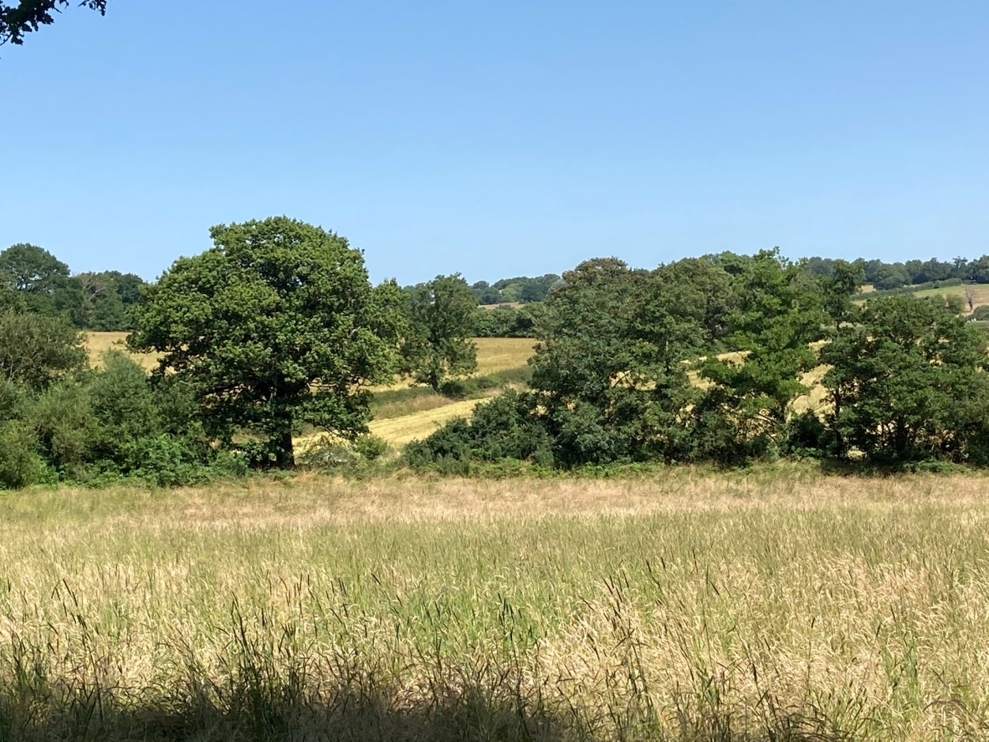
What we’re fighting for
This attractive rolling countryside is what remains of the historic Enfield Chase.
The Chase was enclosed in 1877 and what we see today are the post-enclosure farm fields and hedgerows.
Until now the area has been protected by its Green Belt status, supported by some Local Authority policies.
BUT THAT IS CHANGING!

Slide 4
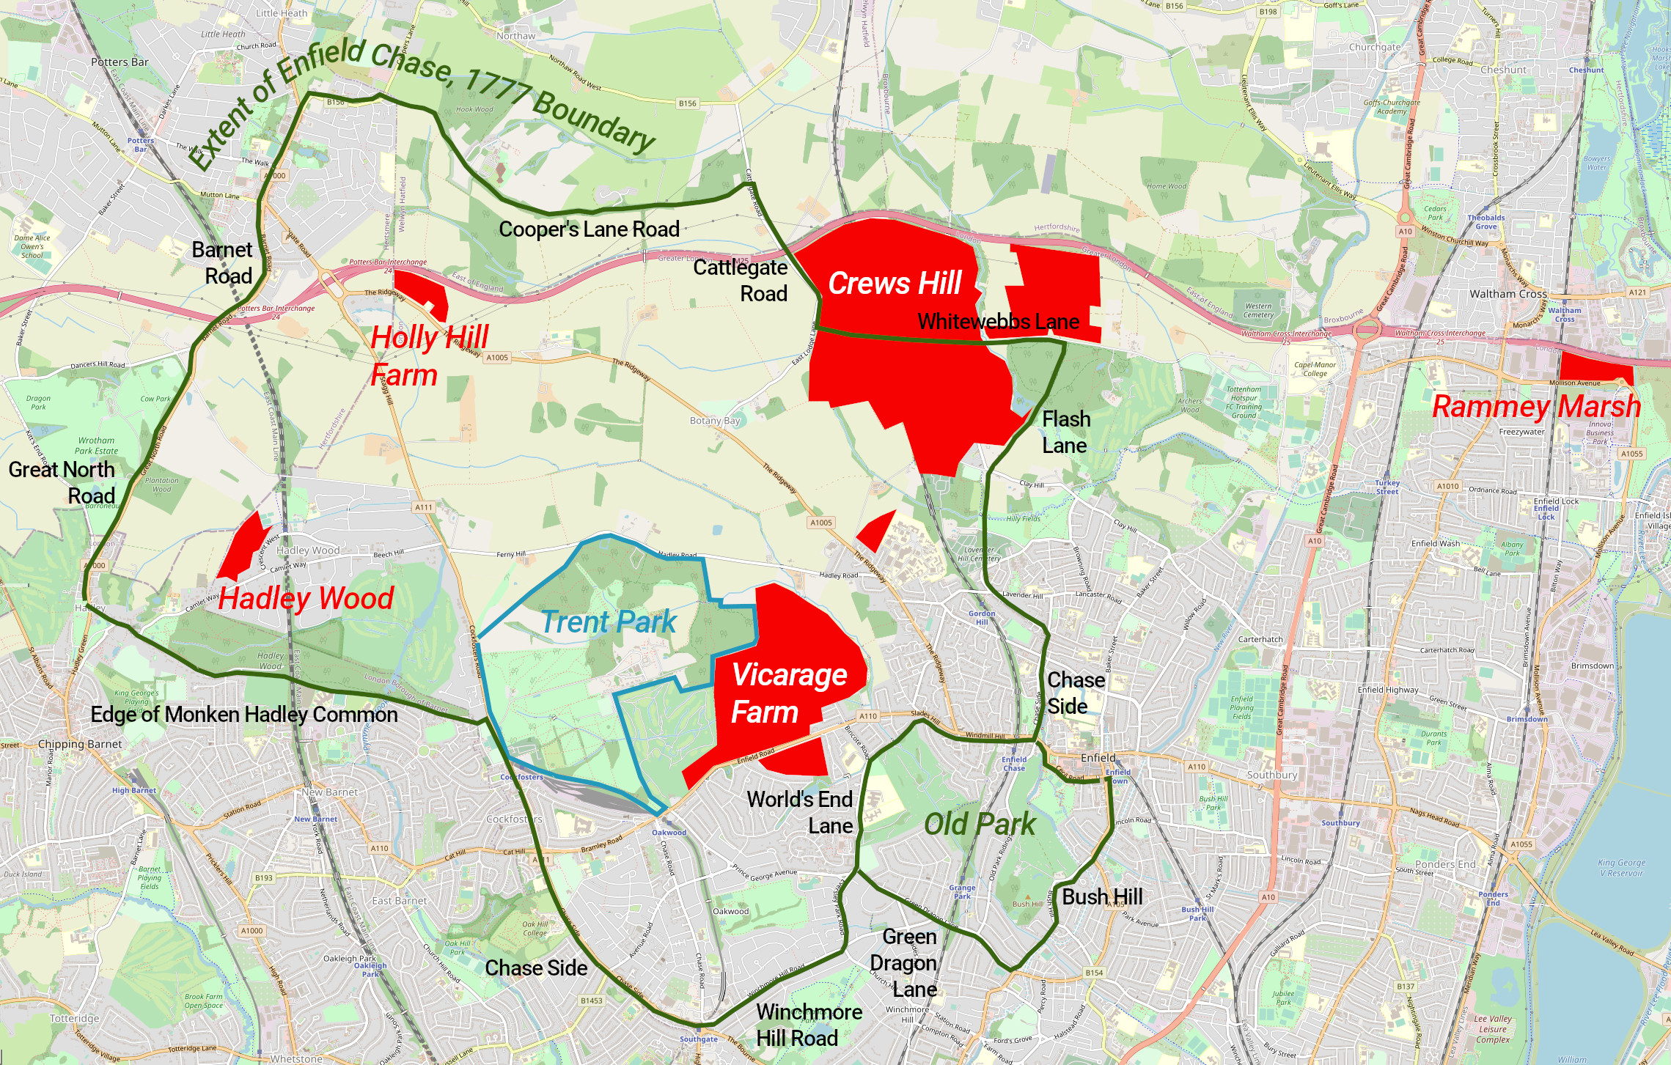
Enfield’s draft local plan is currently in its examination phase. The areas in red show the Green Belt areas that the Council proposes for development, providing some 13,000 new homes. The Inspector has yet to rule on whether these sites are ‘sound’.

Slide 5
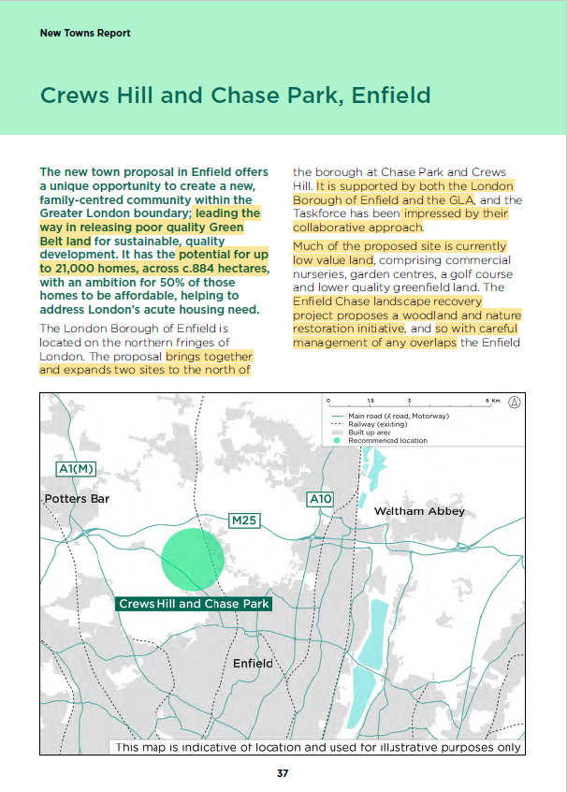
The New Towns Taskforce Proposal
September 28, the Taskforce released its report, identifying 12 locations for new towns.
Among their top three choices is Crews Hill and Chase Park, suggested for 21,000 homes and covering 884 hectares, one third of Enfield’s Green Belt.
This is much more extensive than the Council’s own proposals in the Local Plan.
And there are many issues with it.

Slide 6
The New Towns Taskforce Report
The report, as it relates to Enfield, is riddled with vagueness and inaccuracies. It seems to have been written based on Council ‘evidence’ with no independent verification.
The location – a green circle – doesn’t even include Chase Park, but it does include countryside that has received large grants for landscape restoration from DEFRA and others.
The Green Belt land is described as poor quality, when there is considerable evidence to the contrary.
The Crews Hill horticultural area, which is a vibrant employment area, attracting visitors from near and far, is dismissed without comment.
As is Crews Hill Golf Course, a successful heritage course, with a large diverse membership, a long lease and responsibility for the care of a Site of Importance for Nature Conservation [SINC].
Plus there are unsubstantiated claims about the connectivity of the area.

Slide 7
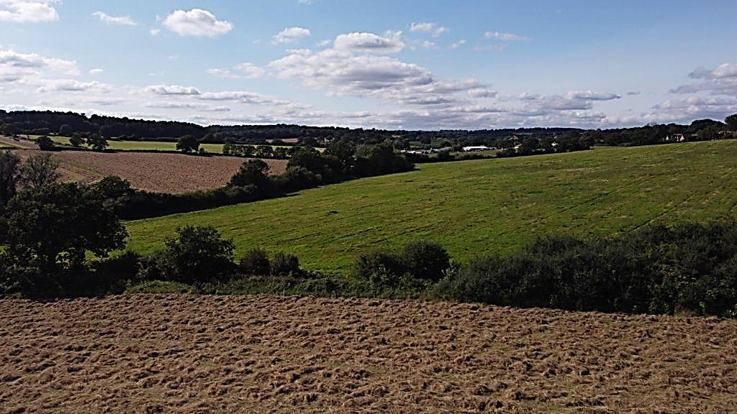
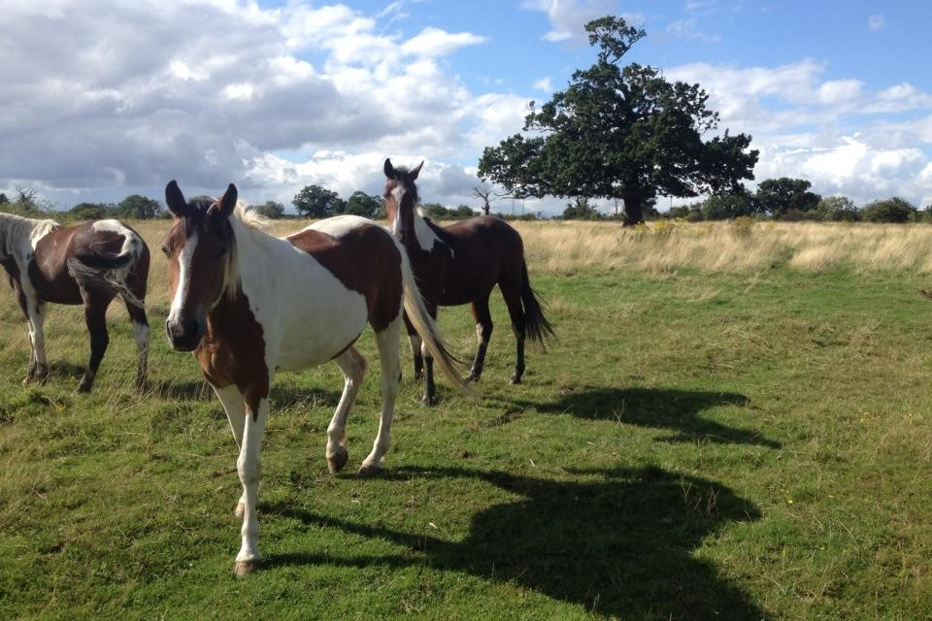
A new level of campaign
The New Towns Taskforce is expected to confirm the list of 12 sites in Spring 2026.
Enfield Council wants it. The Mayor of London wants it. And the Government wants it. But it’s the wrong location for a New Town!
How do we stop this juggernaut and counter the argument that the homes are desperately needed?
Please share your ideas and contacts. enfieldroadwatch@gmail.com

Slide 8
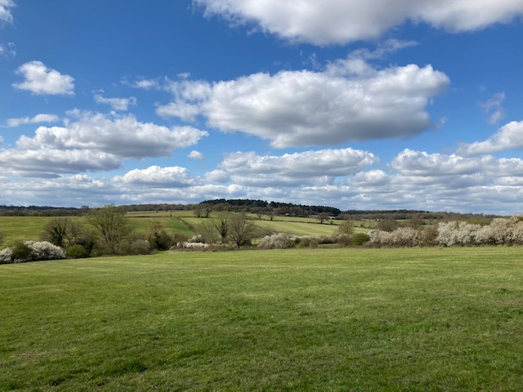

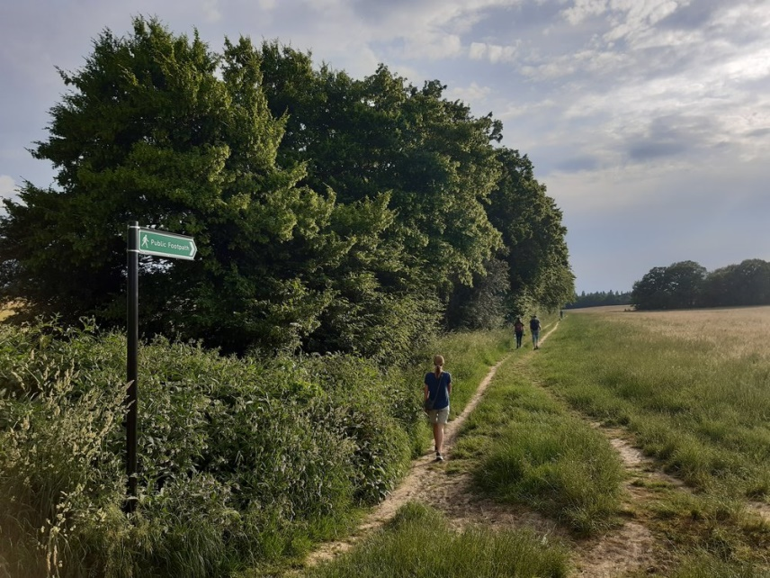
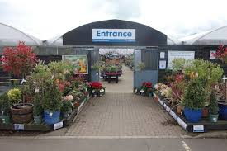
Questions?

