Slide 1
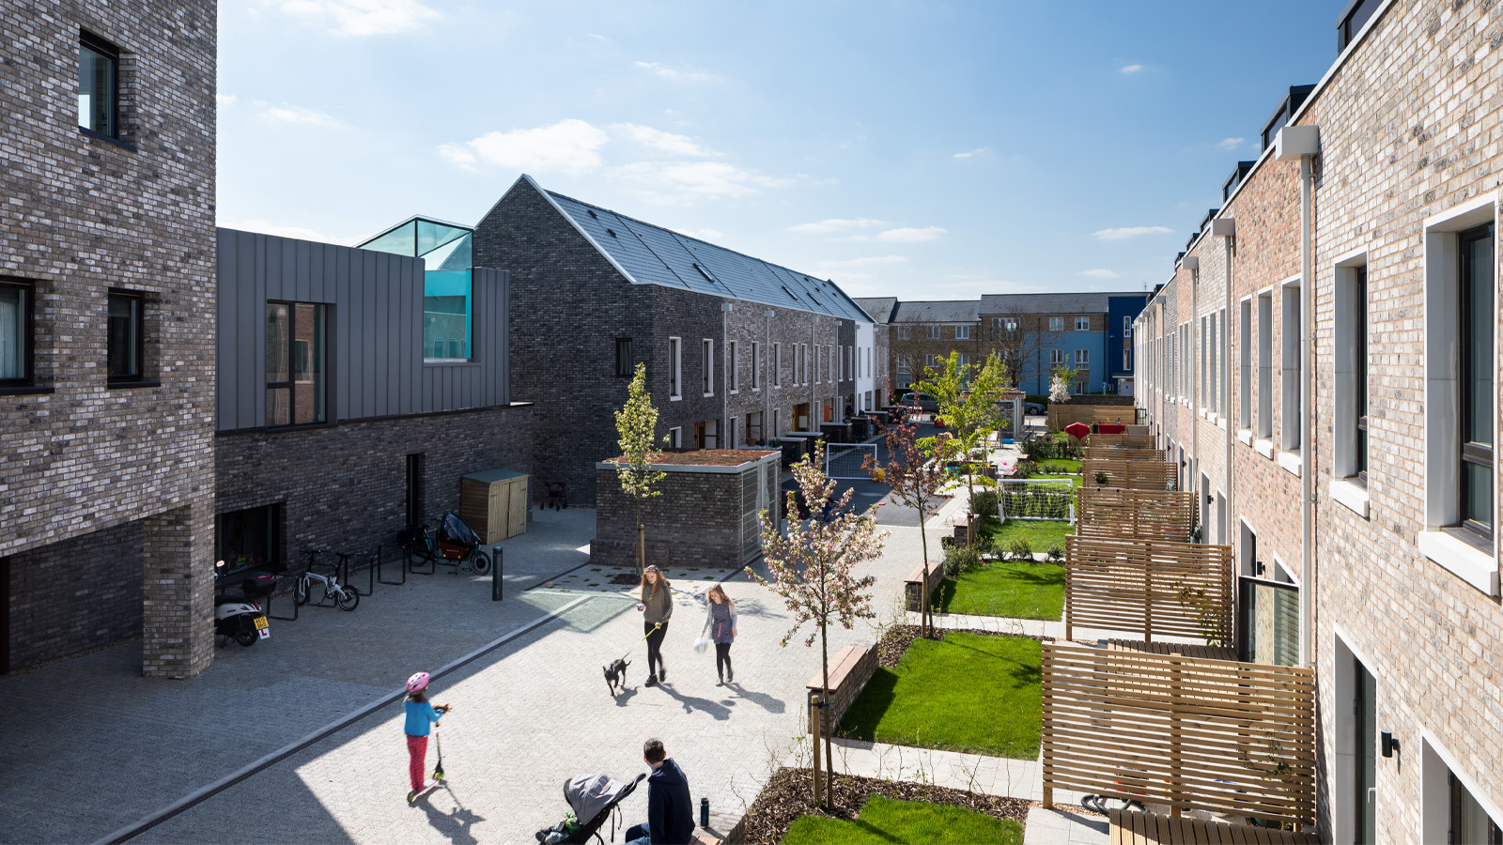


Location of Development - Building in Car Dependency?

Slide 2

Location of Development
What have we looked at?

Slide 3
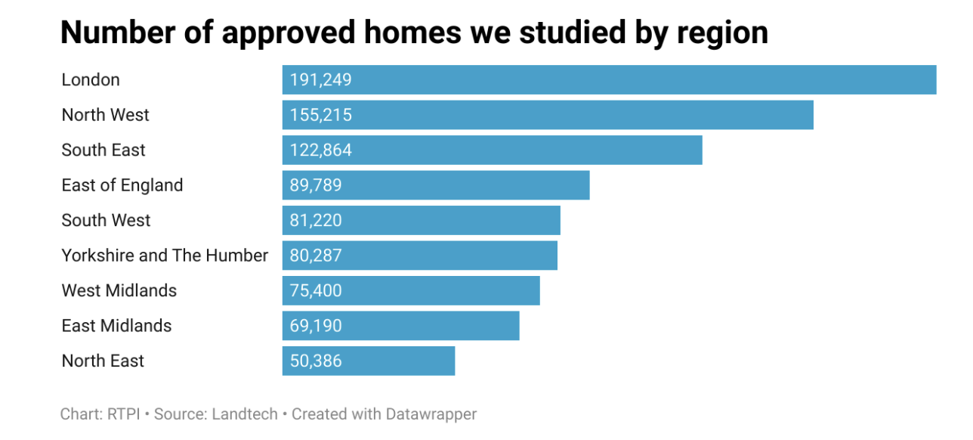

XXX
XXX

Slide 4
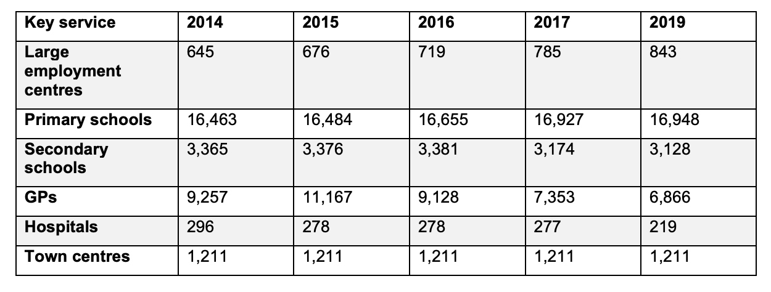
Destinations

Slide 5
Location of Development
What did we find?

Slide 6
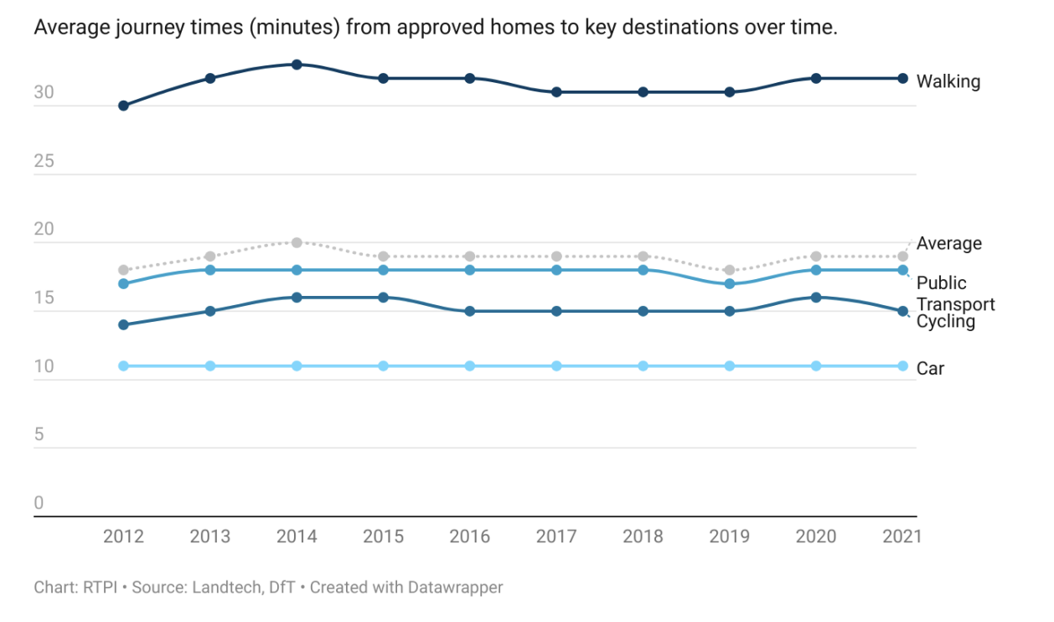

Slide 7
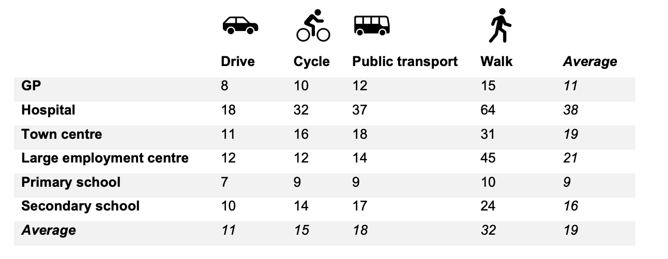

Slide 8
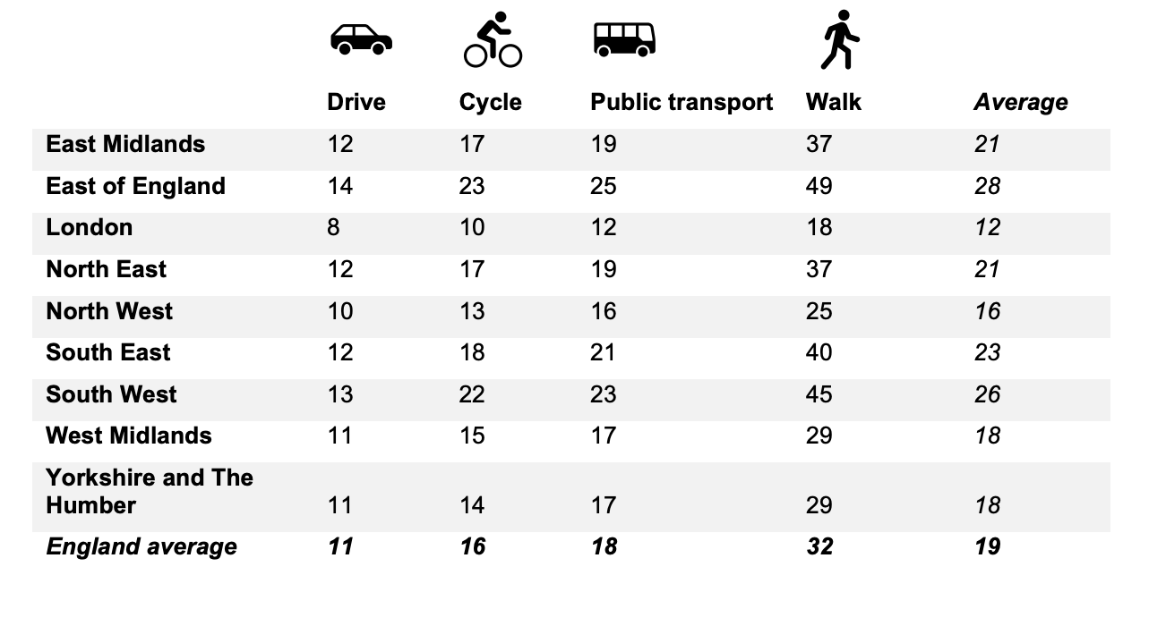

Slide 9
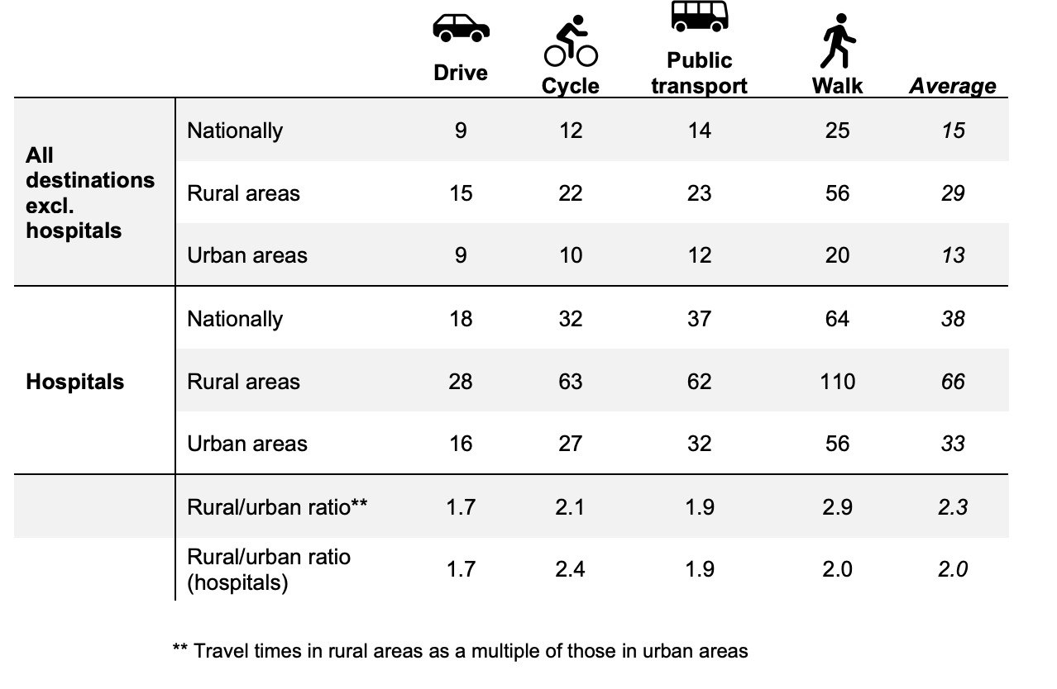

Slide 10
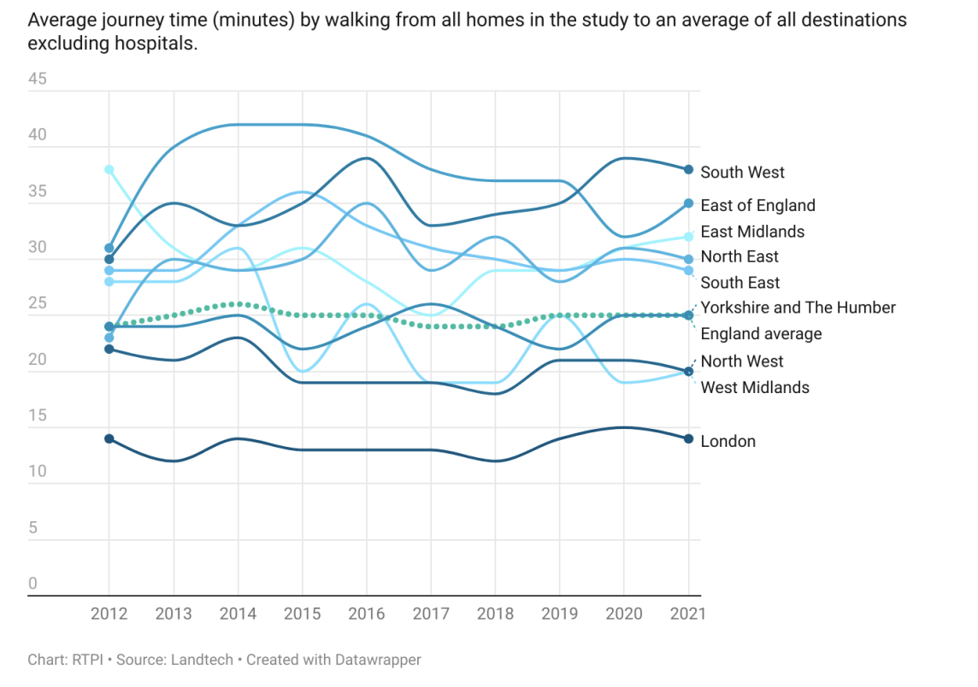

Slide 11
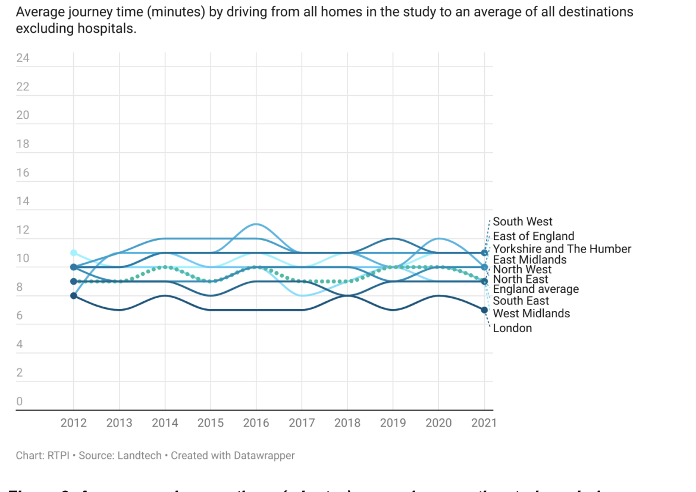

Slide 12
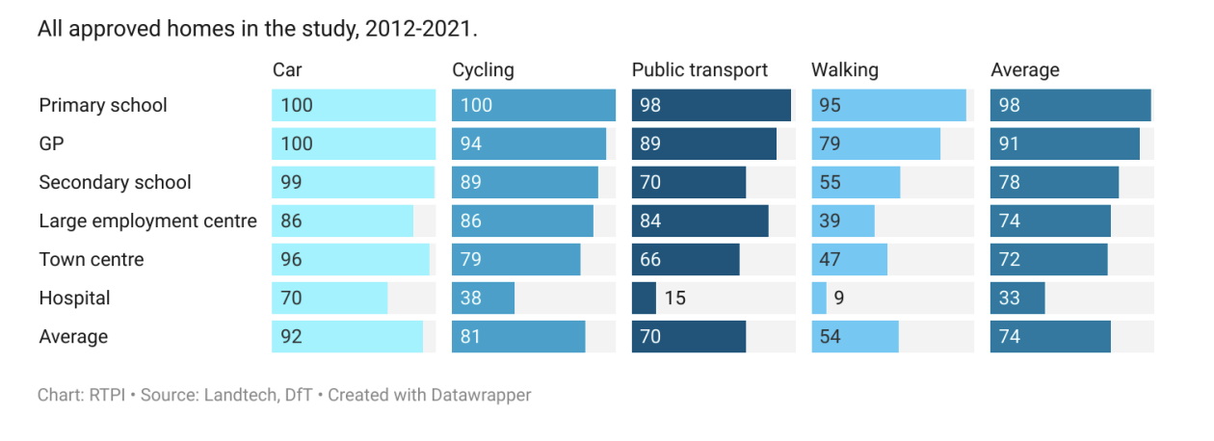

Slide 13
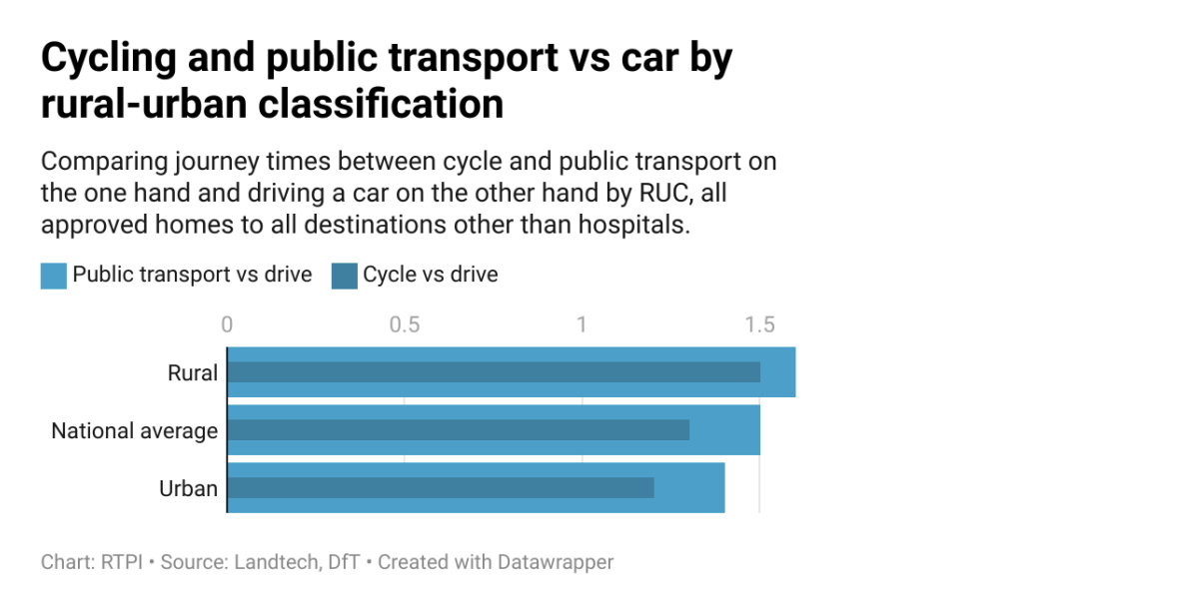

Slide 14

Thank you
Notes:
Read further on blog (block?)
Accessible on community

