Slide 1
Plan for failure
Lots of car parking, poor bus provision
Bus services unattractive
Bus services cut
Demand for more parking / roads
Bus use drops
Congestion rises

Slide 2
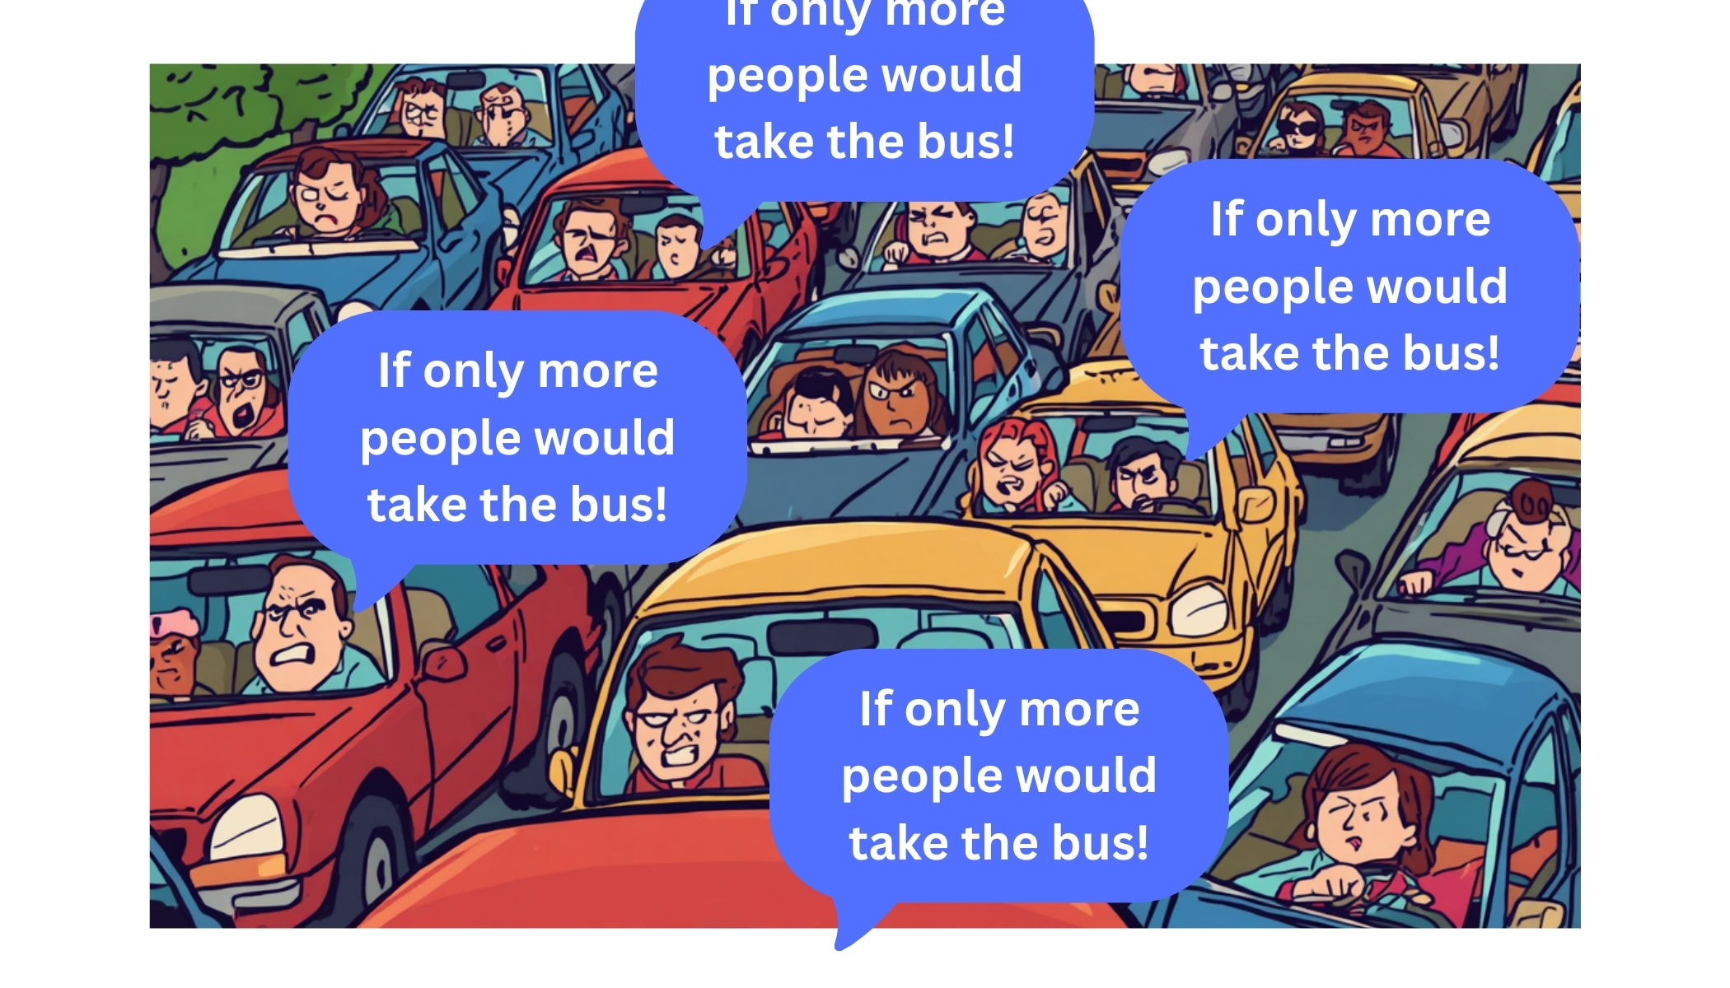

Slide 3
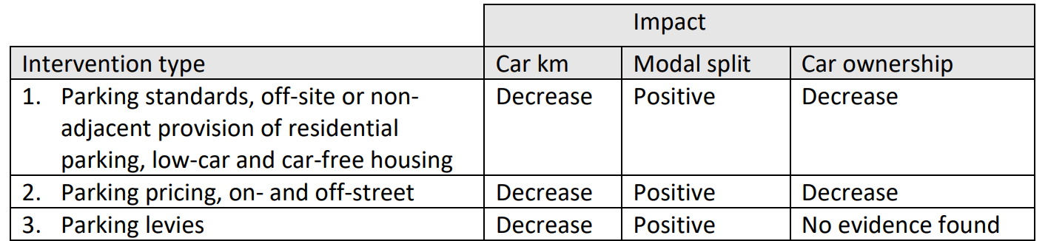
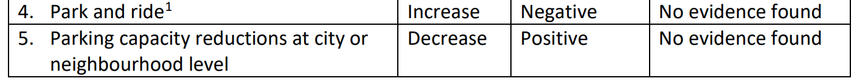
Impact of parking on car use
Reducing car use through parking policies: an evidence review - ClimateXChange, August 2023

Slide 4
Across England, 11.2 million people face a high risk of social exclusion because of poorly performing, inaccessible, and inadequate transport systems.
Transport and social exclusion in the North 2024-25 - Transport for the North, 2025

Slide 5
The economics are key
Buses need:
People paying fares to improve viability
Competitive pricing compared to parking
Good service levels to attract passengers
Priority measures to bypass congestion (to avoid rising costs)
Franchising / funding to provide a comprehensive network
Simplified ticketing
Integrated services

