Slide 1

#3 The Hidden Costs of Free Parking
Parking and The High Street
19th March 2026
Andrew Potter

Slide 2

Arabian Knights Restaurant
Come Dine with Us
Throughout November, we offer you a free glass of champagne with your meal.

Slide 3
North Yorkshire Town
Come Shop with Us
Throughout November, we offer you a free parking space in the heart of the town centre

Slide 4
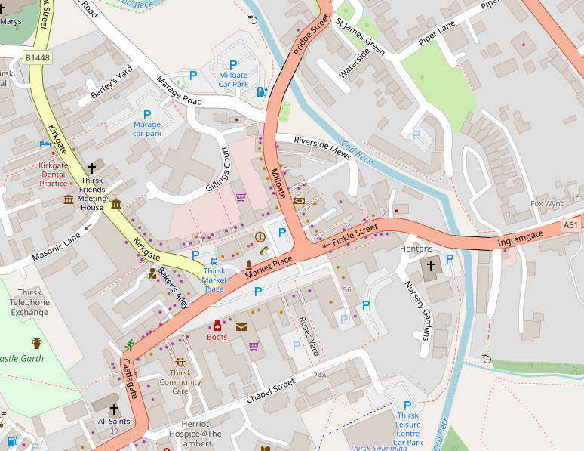
1 hour | £1.40
2 hours | £2.90
3 hours | £4.30
All day | £5.80
Millgate Car Park
N
Thirsk
Marage Car Park
Market Place
Market Place, Thirsk
1 hour free.
2 hours £1.40
Max 2 hours
Nursery Car Park
100m
All day | £5.80
© OpenStreetMap Contributors

Slide 5
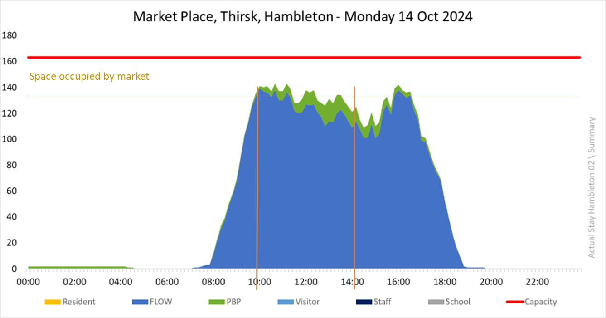

1 hour | £1.40
2 hours | £2.90
3 hours | £4.30
All day | £5.80
Millgate Car Park
N
Marage Car Park
Market Place
Nursery Car Park
100m
All day | £5.80
© OpenStreetMap Contributors

Slide 6
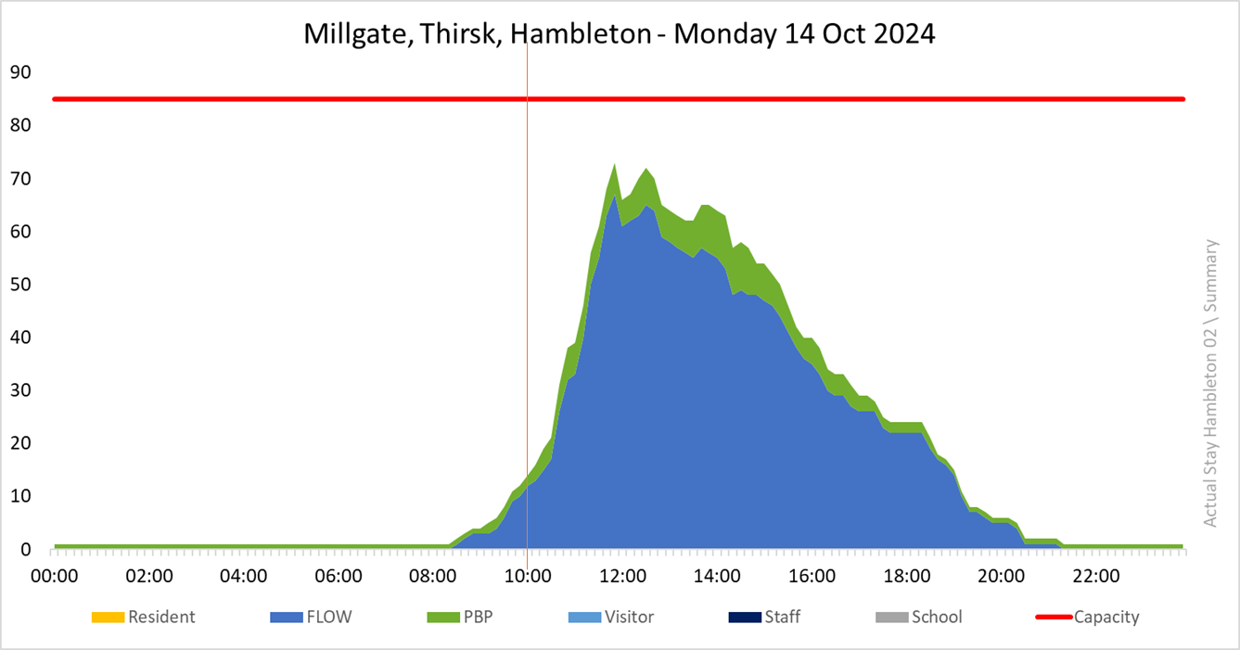
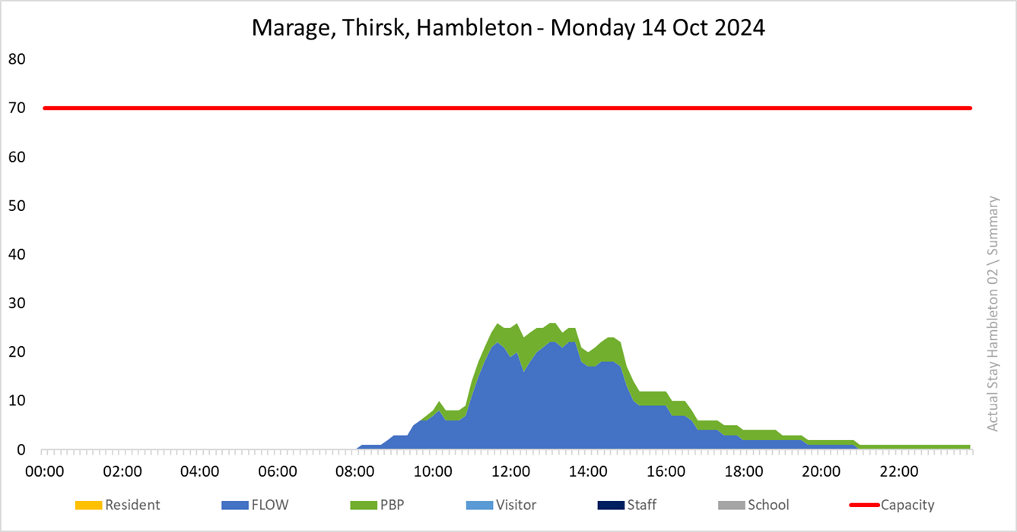
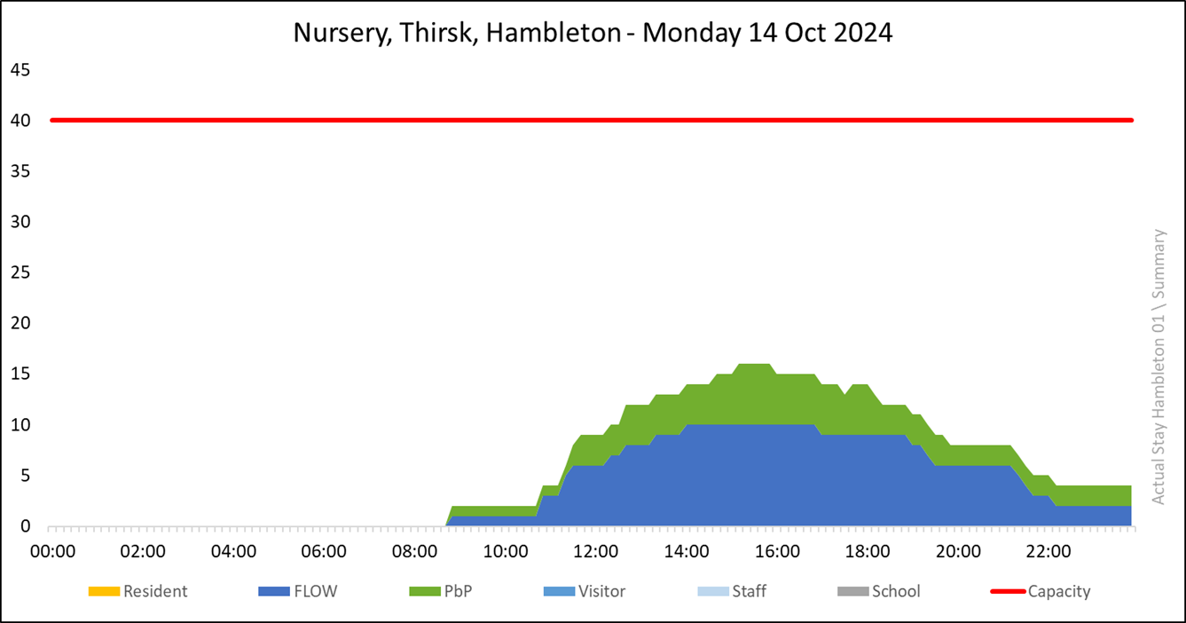
Millgate Car Park
N
Marage Car Park
Market Place
Nursery Car Park
100m
All day | £5.80
© OpenStreetMap Contributors

Slide 7
Market Place at Capacity
10:00
14:00

Slide 8
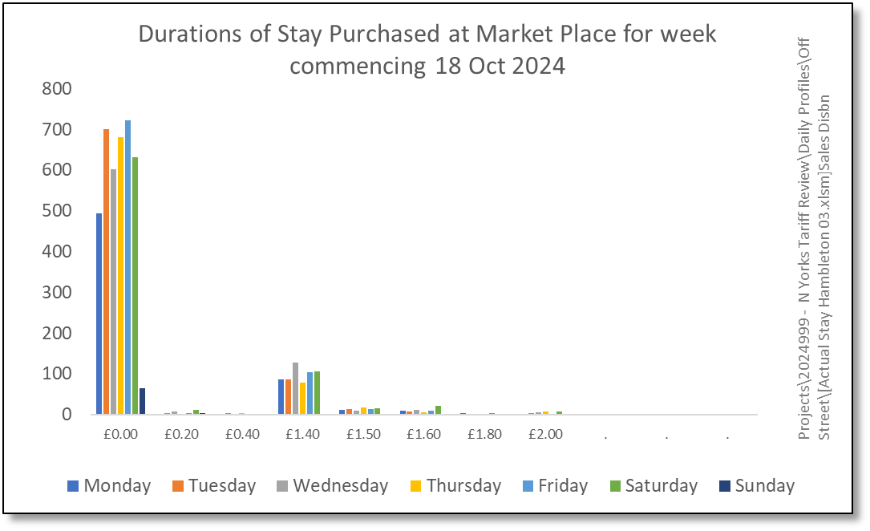
The allure of “free”
In Market Place, when offered with “Free Parking”, very few people are opting to pay for 2 hours.
84% choose to stay for just the hour.
Durations of Stay Purchased Market Place, Thirsk, between 10:00 and 14:00 on Monday 18 October 2024

Slide 9
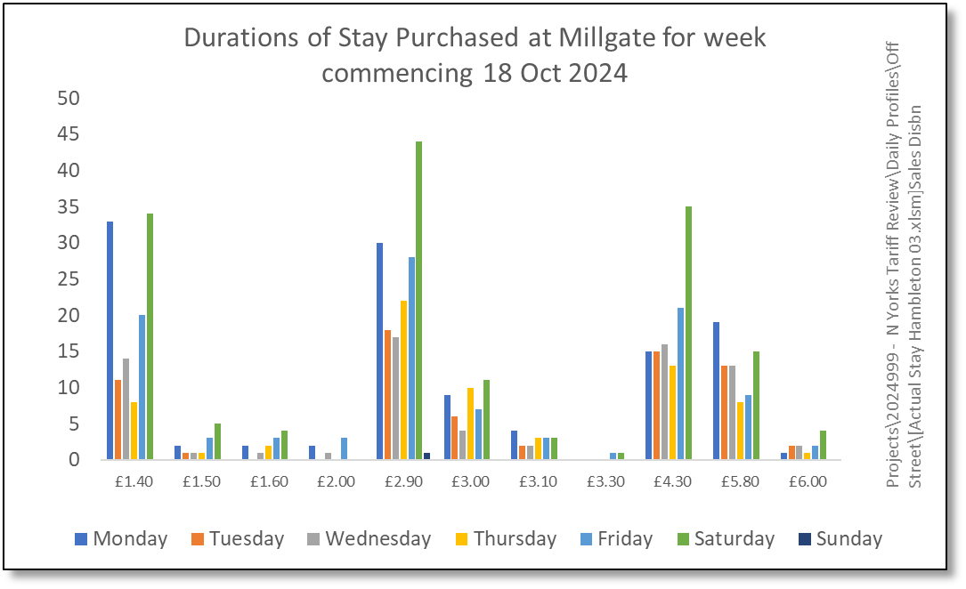
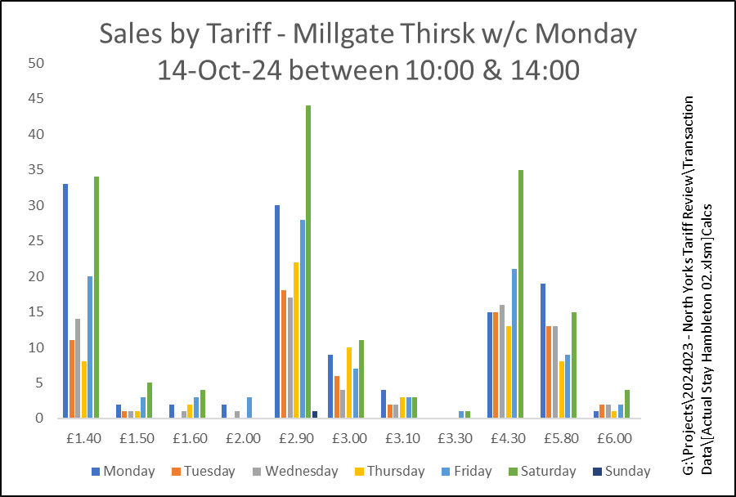
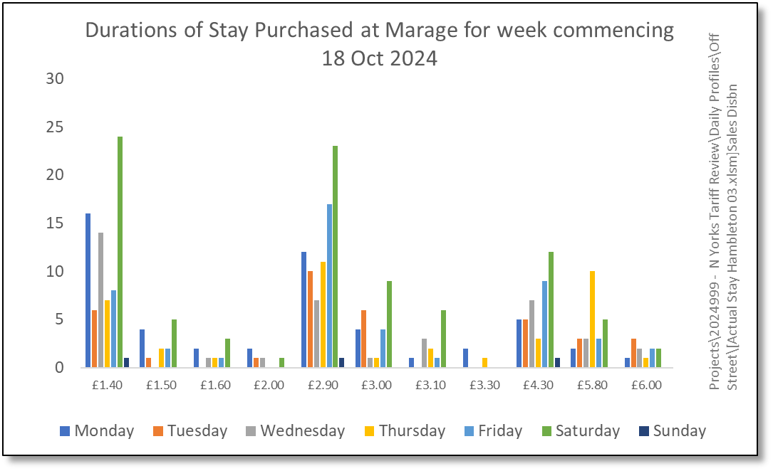
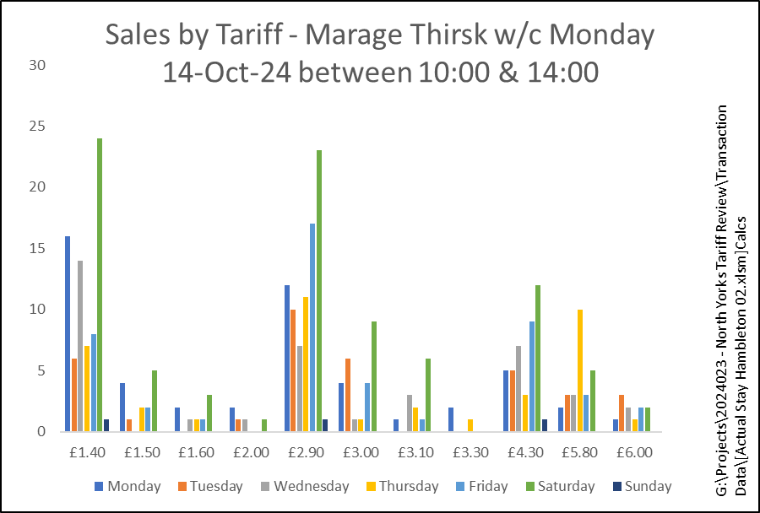
Durations of Stay Purchased at Millgate between 10:00 and 14:00 on Monday 18 October 2024
Those unable to park in Market Place, go to Millgate.
These are not offered any “Free Parking”.
26% buy 1 hour; 39% buy 2 hours; 35% buy 3 hours or more.
Durations of Stay Purchased at Margrave between 10:00 and 14:00 on Monday 18 October 2024
Similarly, those unable to park in Market Place, going to Marage are not offered any “Free Parking”
A third buy an hour, 40% buy 2 hours; 26% buy 3 hours or more.

Slide 10
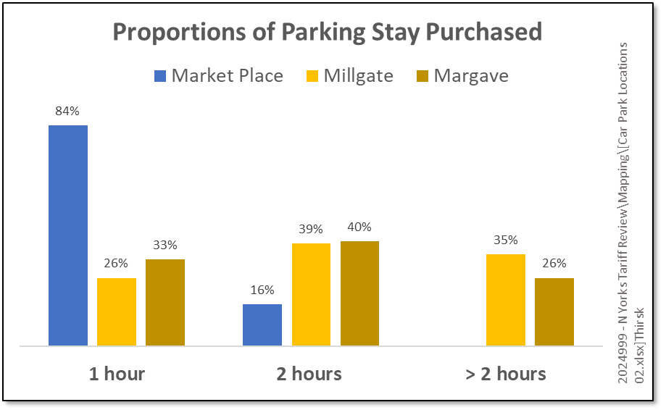

Slide 11
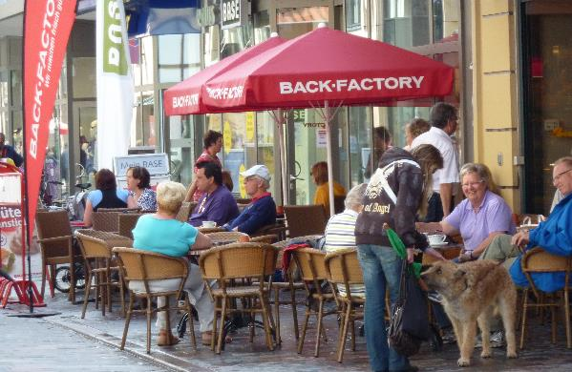
Modern Town Centre: Dwell not Turnover
Changing Shopping Habits - Food and beverage:
1% of floorspace at Brent Cross in the 1970s
Low rent eaves at Lakeside (1980s)
15-20% floorspace amongst higher retail – Westfield, Stratford (2011)
Customers that stop and eat or drink as part of their shopping trip spend up to 48% more on their purchases.
CACI 2015

Slide 12
Modern Town Centre: Dwell not Turnover
On Monday 18th October 2024
1,330 parking events in Market Place during the restricted period of 8-18.
Only 16% of these paid to park for more than the free hour.
Alternative Behaviour
At Millgate and Margave, 40% chose to stay for up to 2 hours
Had Market Place seen 40% stay for 2 hours, that would translate into over 330 additional hours spent in Thirsk. Every day.
Each day visitor contributes over £50 to the local economy
STEAM Tourism Economic Impacts 2023 Year in Review Summary
Those 330 additional hours would be worth around £1.6 million to the local economy per annum.

Slide 13

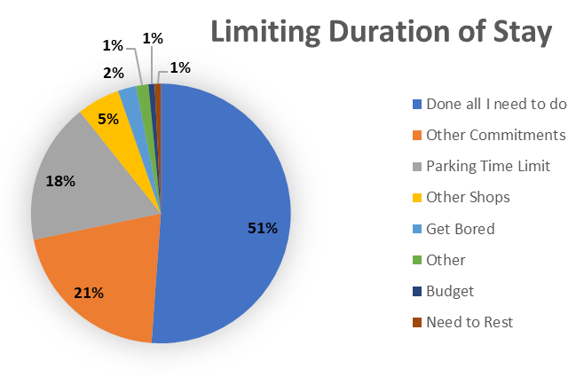
Other Evidence of this - Malton
Malton
Parking Perspectives Survey 2019
n = 135
Notes:
Front Line
The front-line operation is established and demonstrates a maturity in its execution. Roles are clear and the deployment shifts and beat patterns in place are appropriate and working well. Leave cover for the summer months may require additional resourcing or planning.
The Control Room provides a valuable service to staff and providing exceptions and permissions throughout the town for those requiring specific access and parking permissions.
Staff are well trained and supervised until at a satisfactory level for deployment. Front Line staff enjoy a good training regime including evidence gathering. Uniforms process was good, equipment was seen to be recent and appropriate. Welfare accommodation was good. The briefing process and performance management were seen to be done well. There is a process of managing staff activity and their welfare while on the beat; there are aspects here that could be formalised and recorded to provide assurance that standards are being maintained. [20].
The service appears competent. It is achieving very good levels of productivity (1.54 ECNs per hour deployed- In an English city environment expect 1.1 PCNs per hour.) Also has a lower level of appeals and cancellations, indicating that Excess Charge Notices are being correctly and appropriately issued. Payment rates on Notices are higher than typical in England and complaints against staff very low by comparison. Signs and Lines were seen to have integrity with street and were in good condition.
The Beats are well defined and appropriate. Shift Coverage is well-established and understood by staff. The approach, rationale and timescales for rotating staff appears appropriate. The service is very effective in car parks and achieving a good level of compliance. On street there are indications that there is scope for more enforcement to achieve compliance levels to a desirable level of over 95%.The weekday arrangement appears suitable and two shifts provides a good fit of cover to need; the single shift on Saturday appears far less effective.
Sick levels - the underlying average is 5.1 days per year; we might expect 5-7 days/year
Appeals - In 2016, 19% of ECNs issued were appealed. This is lower than the typical range of 25% - 30% common in England. Cancellations due to officer error were at 1%; consistent with good practice elsewhere.
Recommendations
Confirm a set of Key Performance Indicators [23]
Recommendations that include making more of technology: Self service portal [38]; White list for permissions [19]; GPS and heat mapping [18]; Investigate option to use mobile CCTV (scan cars) [17]

Slide 14

Concluding Thoughts
Free Parking needs time limits
Time limits can lead to lost retail revenue
Free Parking attracts users to the destination

Slide 15
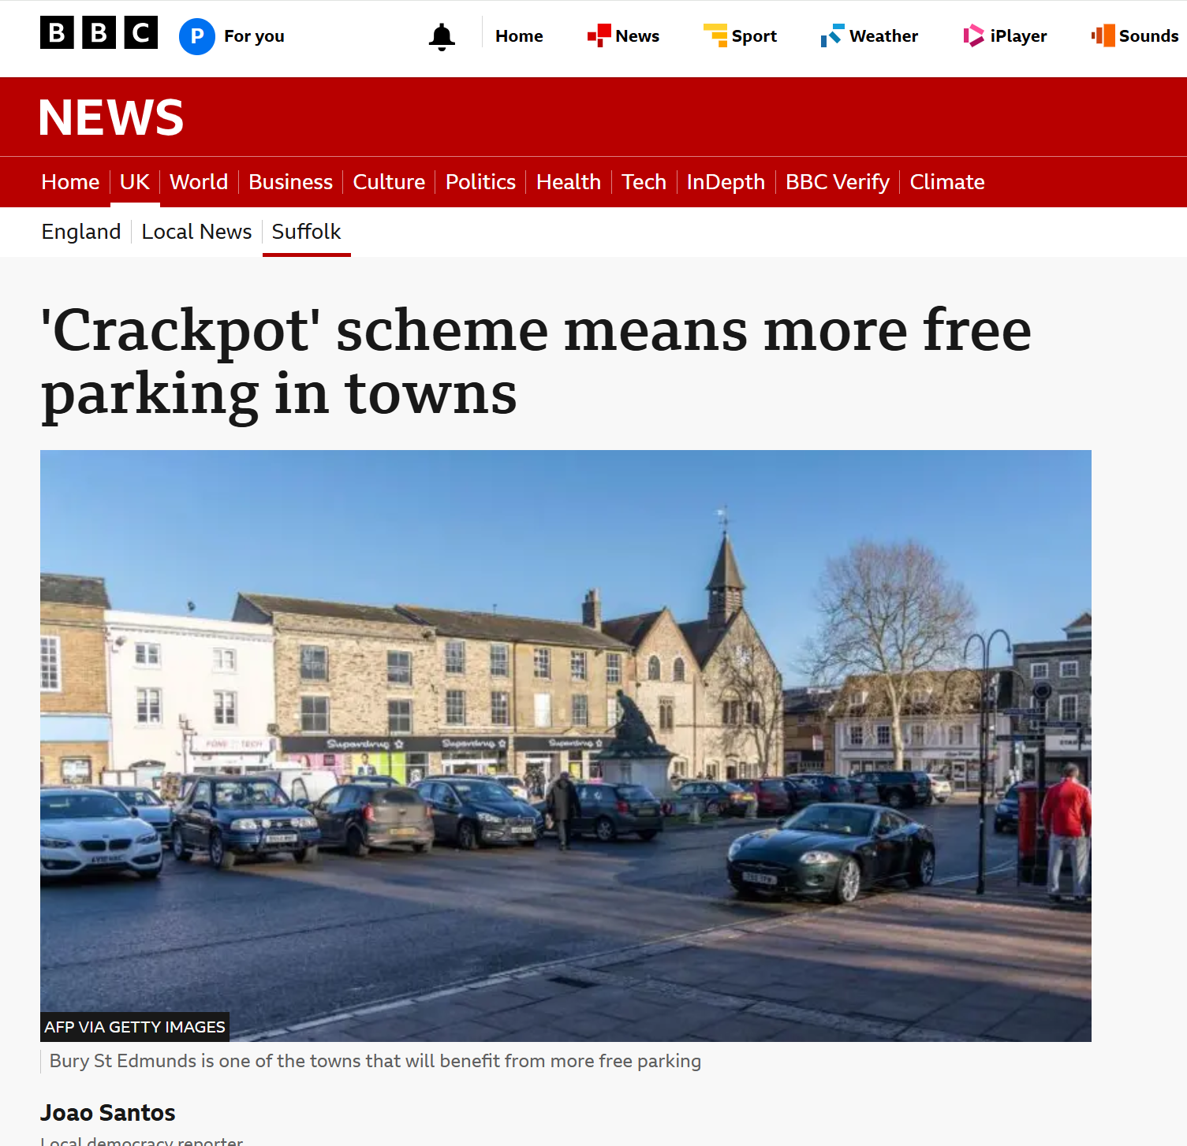
Studies in the series
Parking and The High Street
Parking Charges and Internet Shopping
Rayleigh Trials
The Hidden Costs of Free Parking
The Lure of Free Parking
Still, Tills are Ringing

Slide 16
www.parkingperspectives.com
Parking and The High Street
Oliver House, 23 Hall Street Chelmsford, CM2 0HG
01245 266355

Slide 17
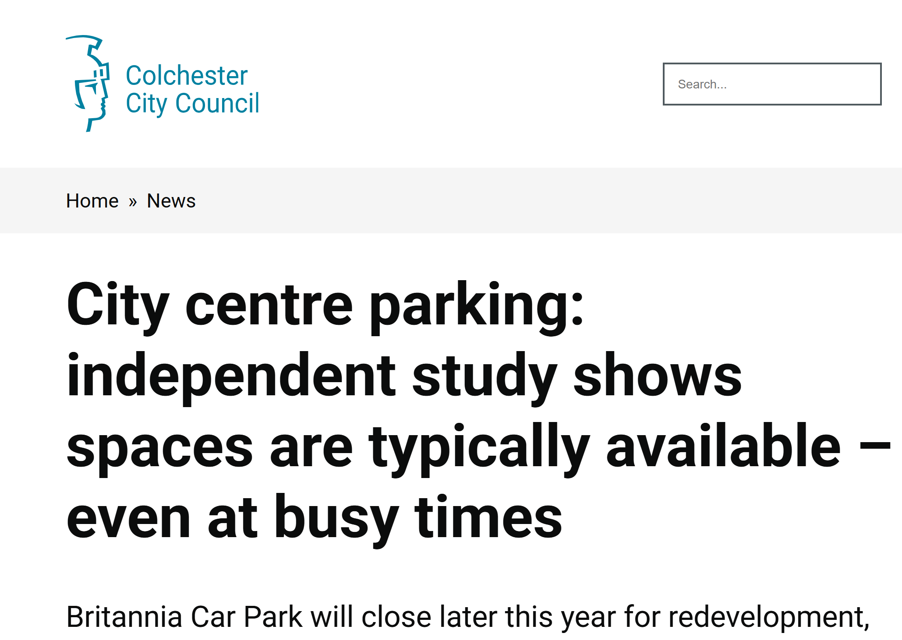
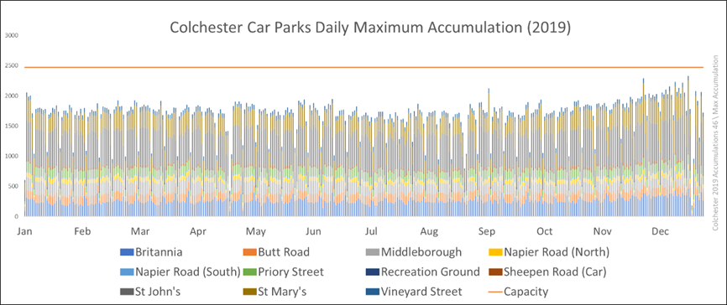
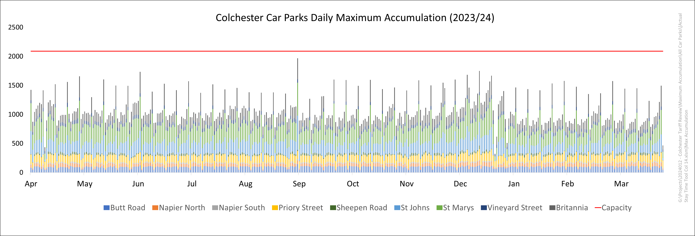
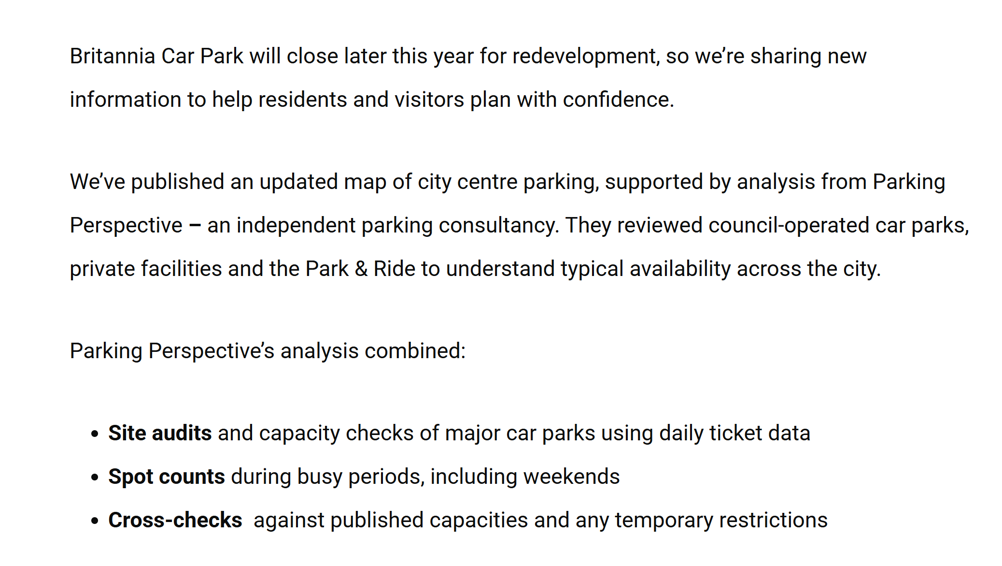
and modelling

