Slide 1
Misconnections
A Regulatory Framework
Lewis Elmes
Catchment Coordinator – London Lea/Brent/Crane
lewis.elmes@environment-agency.gov.uk
EA Incident Hotline: 0800 80 70 60

Slide 2
The Current Resolution Process
(2009 Good Practise Guide)
Outfall Safari
SWOP Waiting List
Pass to Local Authority
Court Action
Pollution Report
SWOP Process
Local Authority Process
Trace back from outfall
Identify properties / appliances
Visit properties
Issue notices and request voluntary rectification
Verify successful works
Outfall gets EA sign off
Write to property owner
Serve enforcement notice
TW verify successful works
Outfall gets EA sign off

Slide 3
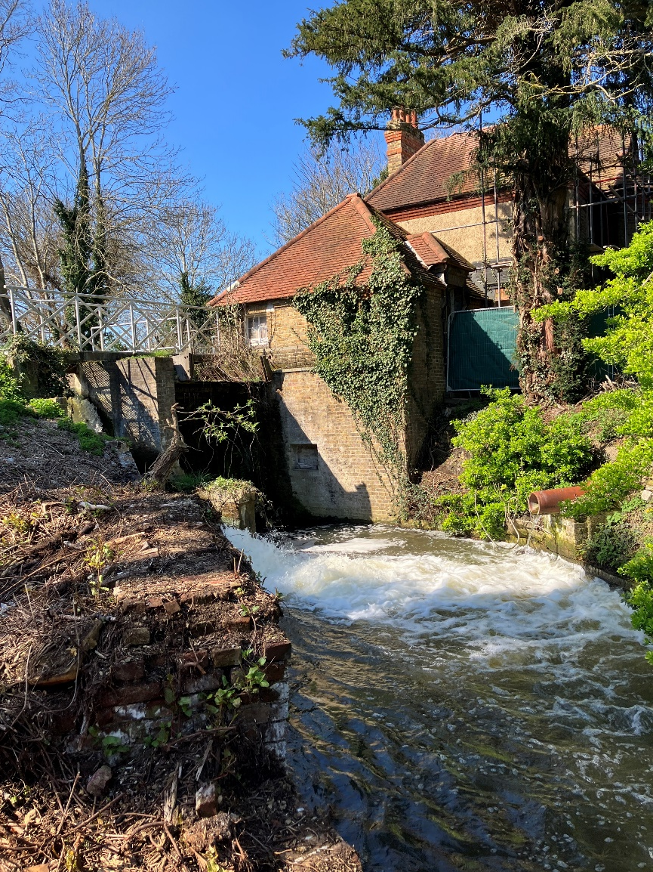
Relevant Legislation
Water Industry Act (1991)
  Section 171
  Section 106 (2)(b)
  Section 106 (2)(c)
  Section 109
  Section 109 (2)
  Section 113
Building Act (1984)
  Section 59
Water Resources Act (1991)
  Section 161A
  Section 85

Slide 4
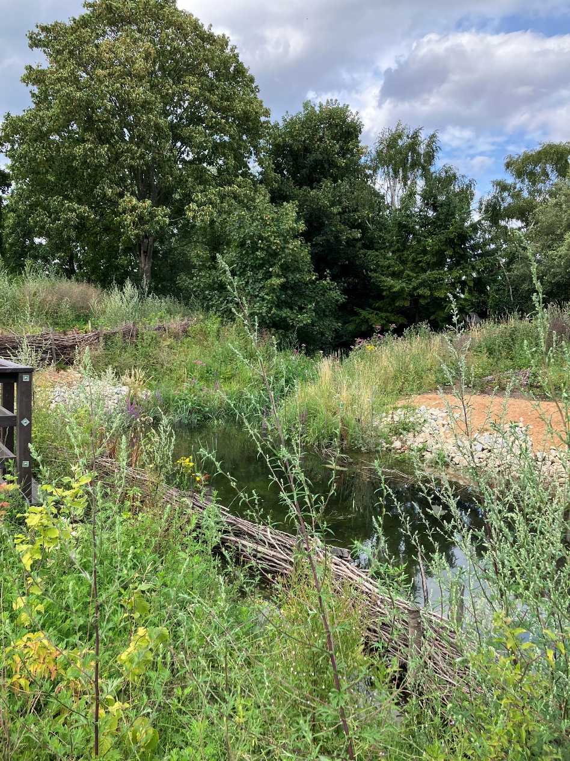
Current Concerns
Resources
Differences of legal opinion
Planning / building inspections
Voluntary rectification

Slide 5
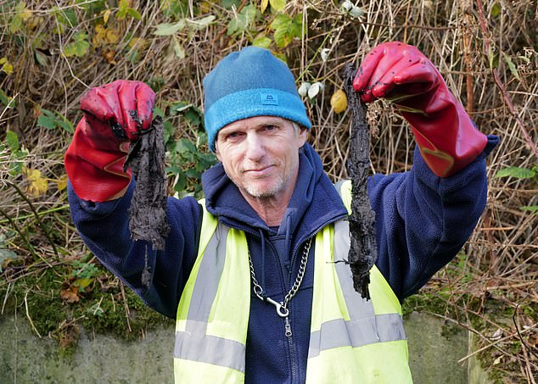
Is there any hope?
Raw sewage from new homes being flushed into London rivers - BBC News
London rivers being pumped full of raw sewage after 'errors' on new-build flats | UK News | Metro News
London housing developments flushing raw sewage directly into rivers | The Standard

Slide 6
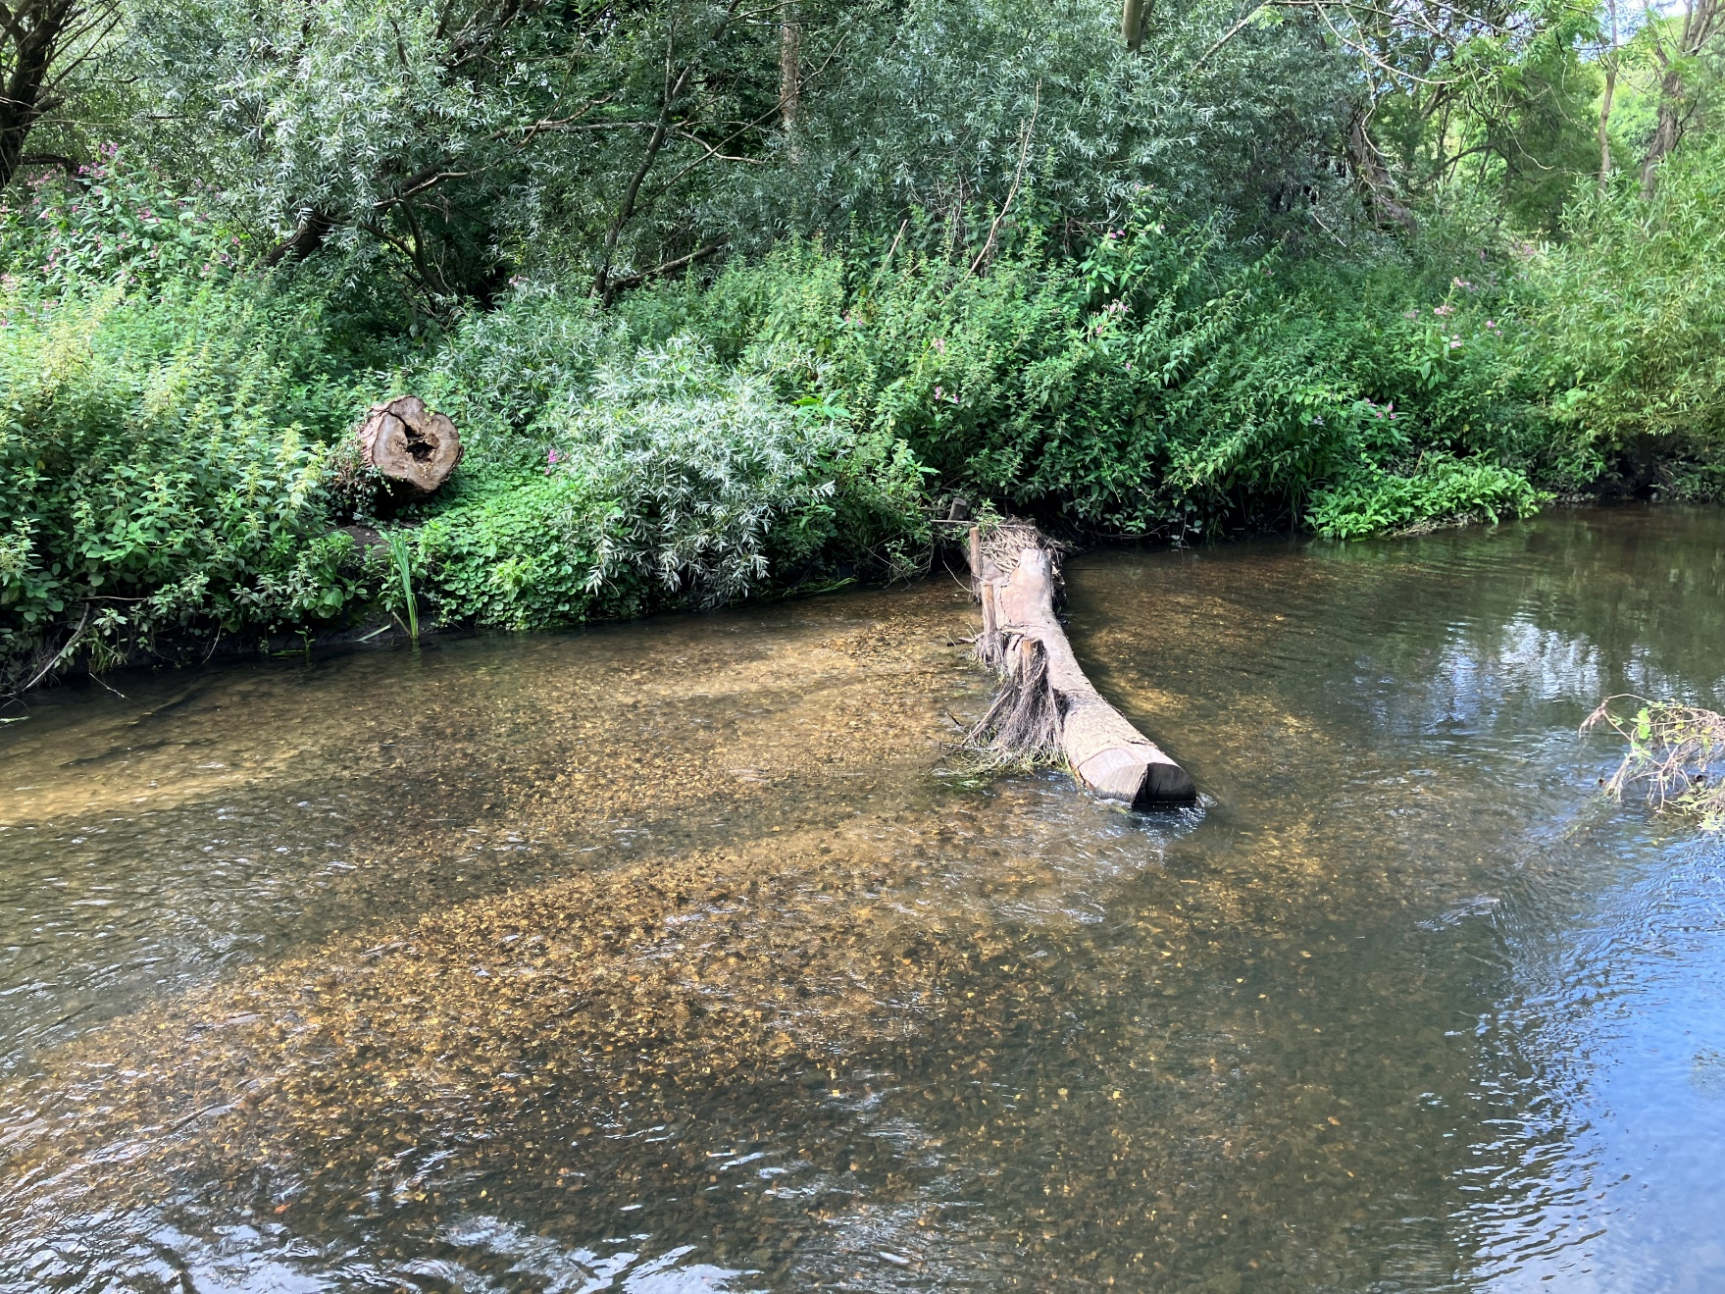
Questions?

