Slide 1

Local Parking Policy
1. Local Authority Parking Policy Benchmark
2. Controlled Parking Zones – comparison
3. Parking finances – comparing income, expenditure
4. Policy for Local Plans
Alice Roberts, June 2026
Campaigns Director, CPRE London
Chair, London Healthy Streets Scorecard Coalition

Slide 2
Why parking matters
[clue: PARKING PROMOTES DRIVING… and takes up tonnes of space]
Saving the countryside (compact cities vs urban sprawl)
Gaining benefits of density (public transport needs 60dwellings per hectare MINIMUM /support more amenities / shops viable)
Public transport works better with less parking
Improved urban realm: streets, historic settings, town centres
Economic recovery (shopping, visitor attractions, labour markets)
Equity - fair use of public space and ££ resources
Freeing up space for play, greenery, bus & cycle, clear pavements
Delivering housing in a good location, including affordable

Slide 3
1. PARKING POLICY
BENCHMARK
The benchmark was developed in consultation with experts and local authorities then turned into an online benchmarking tool here. This dates from 2022 but remains highly relevant. The aim is to update the benchmark from time to time.
More resources: Why boroughs need to reassess parking policy, now! “London boroughs failing to use their ‘most effective tool’ to reduce carbon emissions and pollution - and it's free.”

Slide 4

1. Principles and vision
Do your council’s parking policies:
Acknowledge the need to reduce car use and ownership, and the role parking policy plays in this?
Acknowledge the role parking policy plays in
  A) improving air quality and public health
  B) creating safe and attractive streets?
  C) reducing greenhouse gas emissions?
Commit to make parking policy fair for all residents, not just car owners?
Include a hierarchy of kerbside use that places Blue Badge holders and sustainable uses above car parking?

Slide 5


2. Controlling parking
Do your council’s parking policies:
Include on-street parking in a CPZ wherever it is practical to enforce it?
Include numerous small CPZs rather than a few large ones, with no exemptions for residents of other CPZs?
Levy a surcharge on any additional parking permits beyond one per household?
Take steps to prevent conversion of front gardens to parking, including restricting new pavement crossovers?
State that new housing developments should be car-free wherever possible, and subject to CPZs if not?

Slide 6





3. The cost of parking
Do your council’s parking policies:
Charge a minimum of £150 for a year’s parking permit, regardless of fuel or car type?
Differentiate parking charges by fuel type and/or size, with larger/dirtier vehicles paying more?
Levy a diesel surcharge on parking permit prices to discourage diesel vehicles?
Ensure that there is no free parking within their area of responsibility (except for Blue Badge holders where appropriate)?
Charge no more than one-sixth the price of the cheapest car parking permit for cycle storage (e.g. in a cycle hangar)?

Slide 7


4. Electric Vehicles
Do your council’s parking policies:
Acknowledge that EVs are still not a sustainable form of transport, and should come below active and sustainable travel in hierarchies of use?
Acknowledge the social cost of EV parking, including use of public space and risk of increased congestion, with EV parking costs that reflect this?
Acknowledge that electric vehicles are preferable to fossil fuel vehicles, and reflect this in policies such as parking permit prices?
Include a commitment that new EV charging infrastructure will be put in the roadway, not on the pavement?

Slide 8




5. Accessibility and the pedestrian environment
Do your council’s parking policies:
Provide adequate Blue Badge parking wherever there is need, to be removed only following a thorough audit?
Commit to tackling Blue Badge fraud and abuse?
Recognise that parking policy has an impact on disabled people who don’t drive, as well as those who do?
Use kerb space to maximise accessibility for disabled people who are non-drivers, for example with wide, clutter-free pavements?
On longer side and residential roads, commit to removing parking to install crossing points with drop kerbs and clear sight lines, at minimum every 100m?

Slide 9



6. Short stay parking
Do your council’s parking policies:
Acknowledge that reducing the supply of short-stay parking is a way to reduce car trips?
Charge an amount for short-stay parking that is at least equal to the cost of a return bus trip?
Commit to removing short-stay parking in high-access areas, such as town centres and high streets, to improve the public realm?
Levy a charge for workplace parking on businesses above a certain size?

Slide 10

7. Reducing parking
Do your council's parking policies:
Employ an accurate and up-to-date audit of kerbside use as the basis for setting parking policy?
Include targets and incentives for reduction in the amount of space dedicated to parking, within a fixed time frame?
Include simple, well-publicised mechanisms whereby parking space can be switched to sustainable uses - such as parklets or cycle storage - in response to resident demand?
Include an assessment of parking at all council-run workplaces, including schools, depots, etc, with steps set out to reduce it?

Slide 11






8. Pedestrian Environment
Do your council's parking policies:
Mandate the removal of parking to make way for installation of new street infrastructure, including street trees and EV charging?
Requisition kerb space for planting, for example sustainable drainage systems (SUDS)?
Allow for the use of kerb space to create places for people to relax and play, such as pocket parks?
Include a commitment to end pavement parking wherever it is currently allowed?
Require no dips in the pavement where drop kerbs are installed?
Require the use of double-yellow lines to prevent parking within 10 metres of all junctions, improving visibility for pedestrians and other vulnerable road users?
Indicate that your council has signed up to Transport For All’s Equal Pavements Pledge?

Slide 12





9. Active, shared and sustainable travel
Do your council's parking policies...
Mandate the use of kerb space to ensure demand is met for cycle parking and storage, including cargo bikes and adaptive cycles?
Allocate kerb space exclusively for car club vehicles/car sharing?
Allocate kerb space for cycle/scooter hire?
Mandate the removal of parking in order to make space for bus and cycle lanes?

Slide 13

10. Parking in housing estates
Do your council's parking policies:
Require estate parking to be included in CPZs of the same standards applied to on-street parking?
Require that estate parking permit prices are in line with on-street parking permits?
Require adequate cycle storage on all estates?
Demand that estate parking is subject to the same principles of conversion to sustainable uses as on-street parking?

Slide 14
2. CONTROLLED PARKING ZONES
Car parking is an ‘enabler’ – i.e. it enables people to make car trips. The other big enabler is road capacity: more capacity = more traffic.
To reduce traffic congestion and get people back on buses, controlling and limiting parking is extremely important.
In London, the Healthy Streets Scorecard coalition has mapped controlled parking in all 33 London boroughs, enabling boroughs to compare themselves with other boroughs.

Slide 15
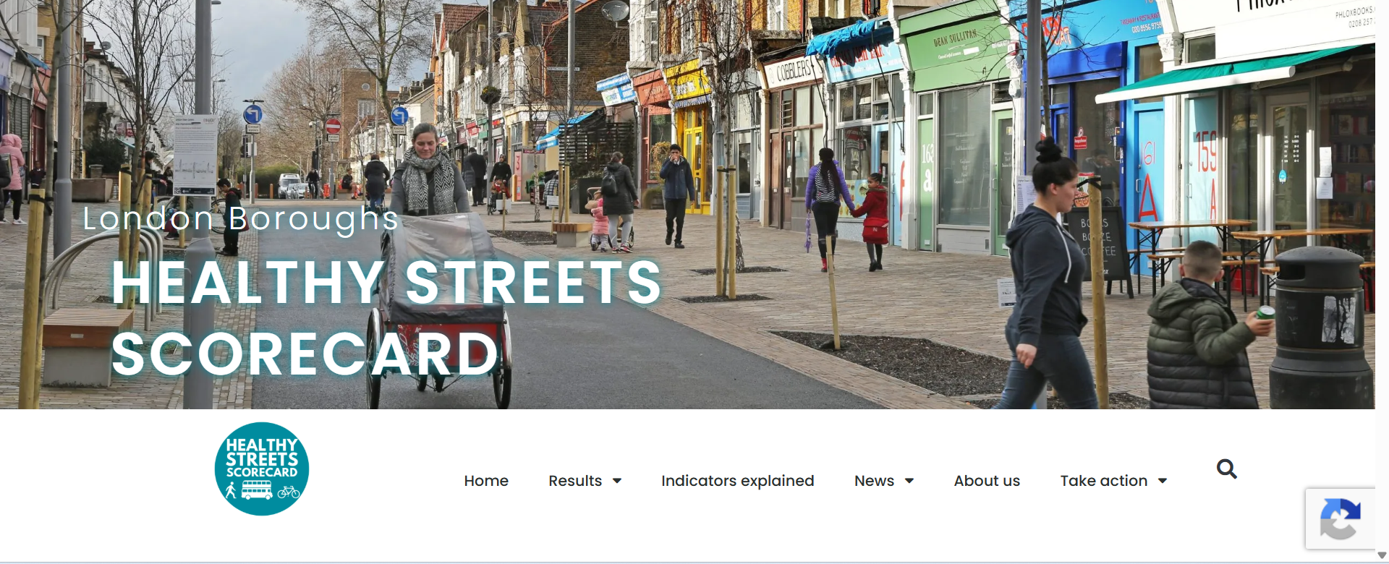
London Boroughs Healthy Streets Scorecard

Slide 16
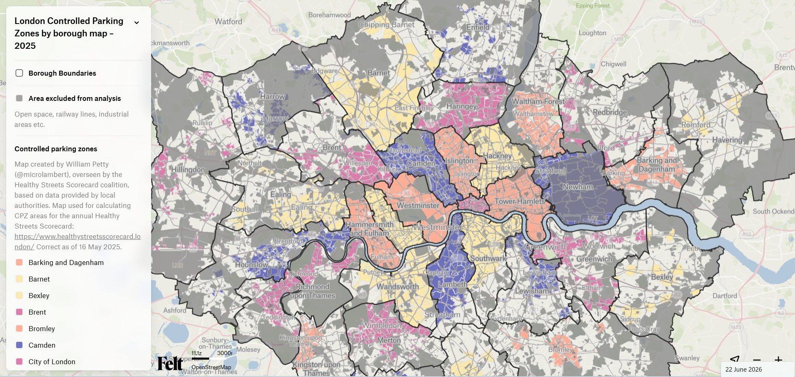
London’s CPZs mapped (and scored)

Slide 17
3. PARKING FINANCES
Compare
Councils’ income, expenditure and surplus
And commentary on what surplus is spent on
… by checking the RAC’s annual report.

Slide 18

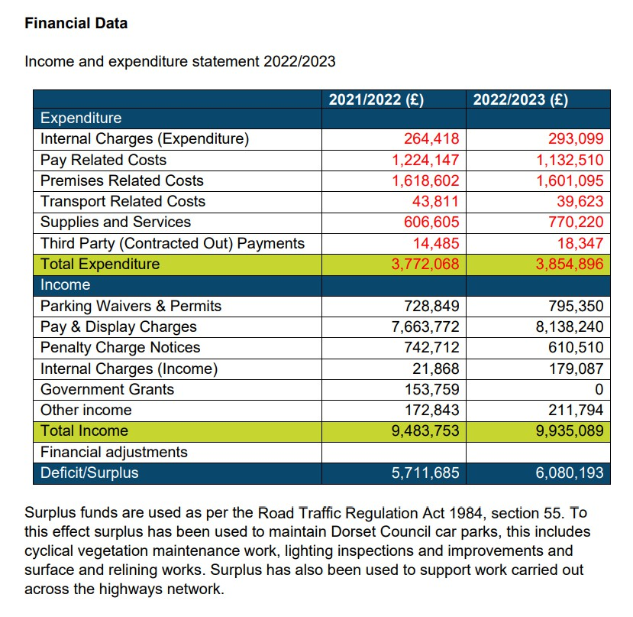
Using parking surplus
By law, councils must publish their parking account information
The surplus can be significant e.g.
£6m in Dorset 2022/23
Councils must use surplus for specific purposes relating to transport
They can use it to support concessionary fares and many do
https://www.dorsetcouncil.gov.uk/documents/35024/285835/DC+Annual+Report+2022.2023.pdf

Slide 19
Council parking revenue in England 2024-25
Councils in England – combined surplus of almost £1.1 billion from their parking activities in 2024-25, RAC Foundation analysis concludes.
Based on data from the 295 local authorities in England (out of a total of 317) that had reported data to MHCLG
Total income from on- and off-street parking of £2.163 billion in 2024-25, and total expenditure of £1.07 billion
https://www.racfoundation.org/research/economy/council-parking-revenue-in-england-2024-25

Slide 20
4. PARKING POLICY FOR LOCAL PLANS
These policies were developed in consultation with the Better Planning Coalition, Transport for New Homes, and others. They were published as part of a project which ran 2025 – 2026.
The report Urban sprawl in England ‘forgotten disaster of last 50 years’ has more detail
Also, lots of useful evidence here Local Plans & Local Transport Plans: delivering better transport

Slide 21
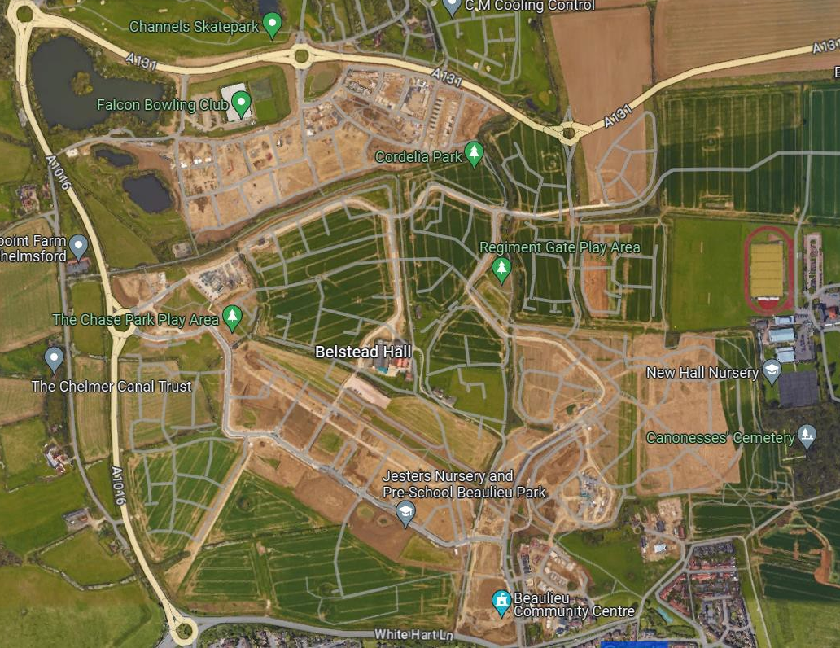
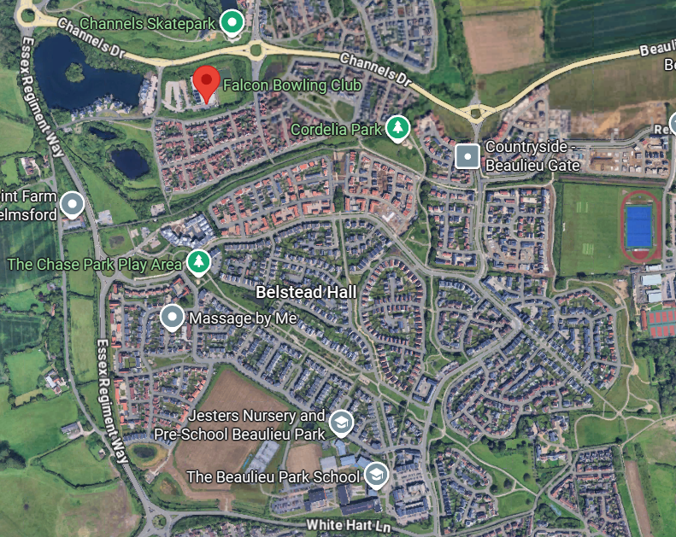

Ubiquitious pattern of development = loss of productive land for low–density, car-dependent development

Slide 22
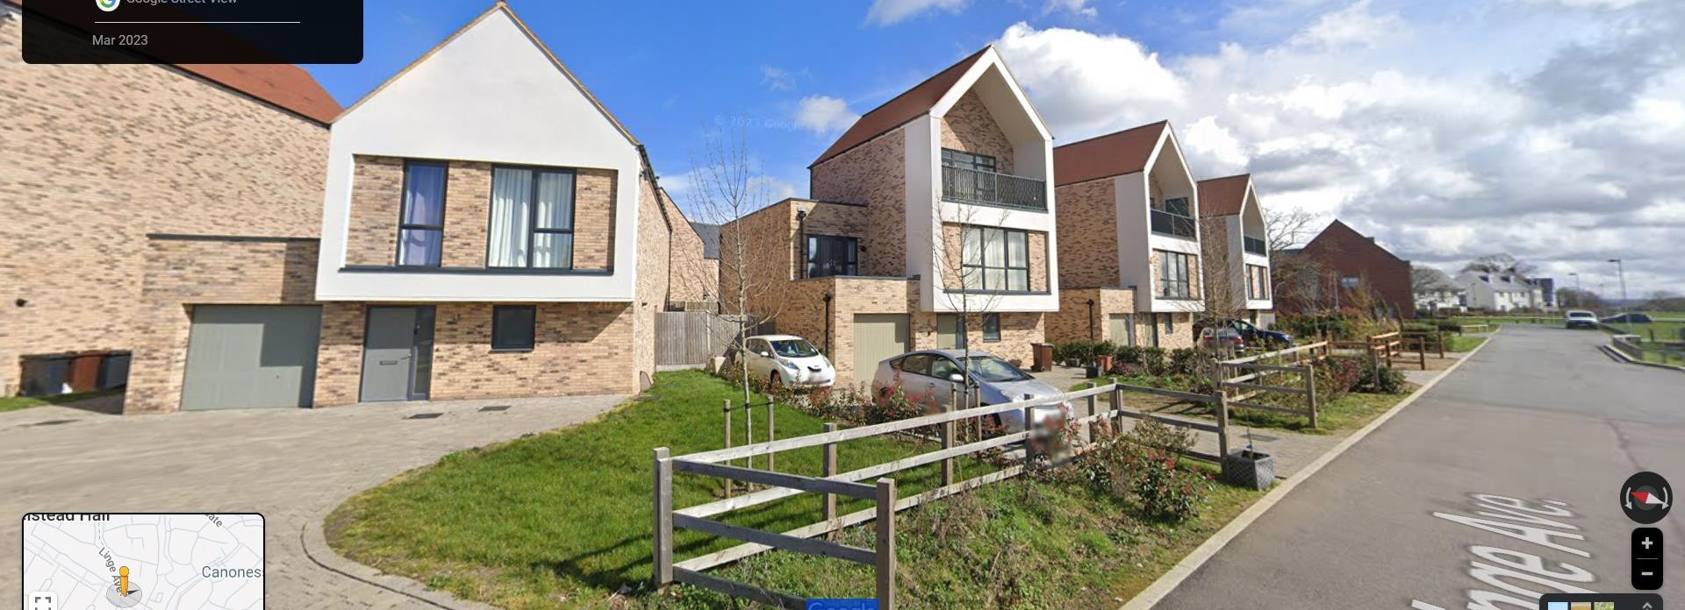
But we lock-in a high-carbon, car-dependent future
‘Parking standards’ or ‘parking ratio’ e.g. @ 2:1 parking spaces is normal, assumption that cars will be needed and used

Slide 23
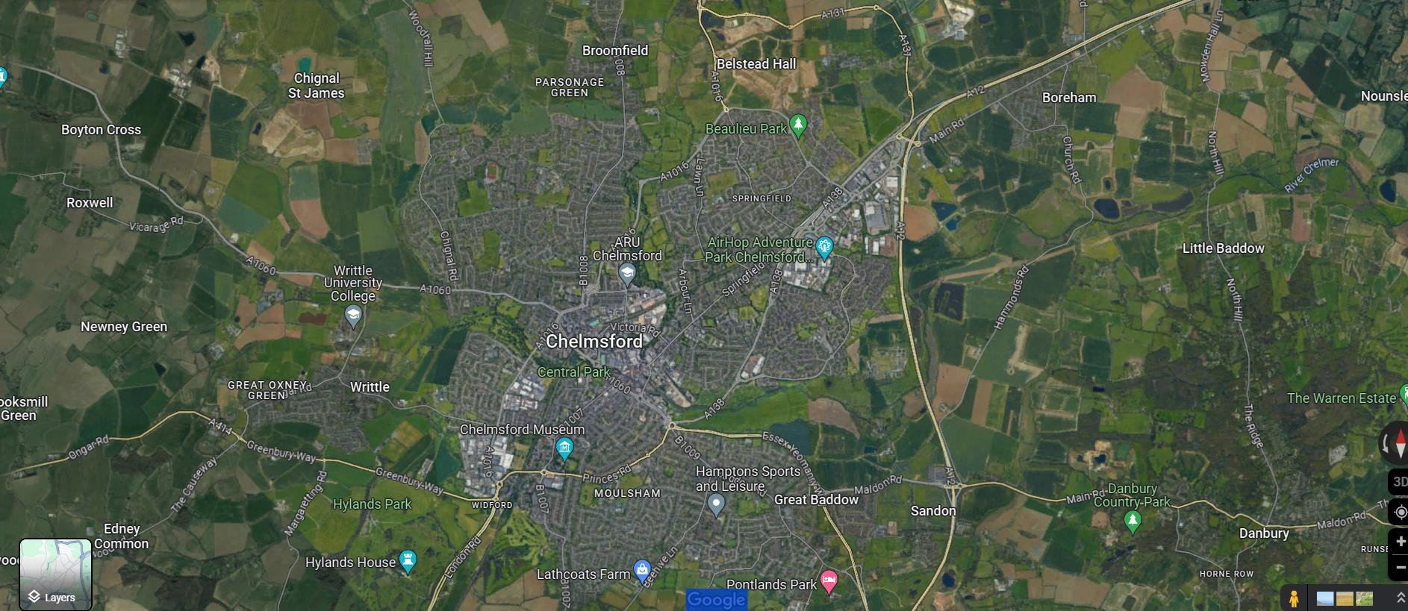
Chelmsford: should be easy to walk / cycle / bus

Slide 24
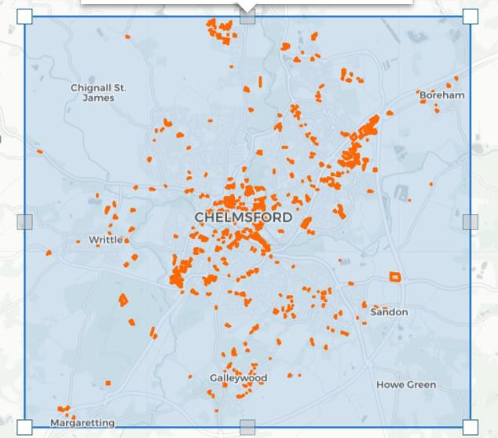
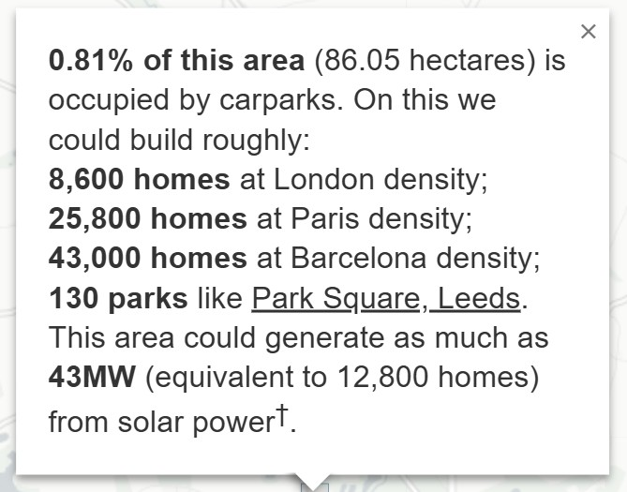
Chelmsford car parks
Identified by the Parkulator tool
NOTE : ‘London density’ is assumed here
to be 100 dwellings per hectare.

Slide 25
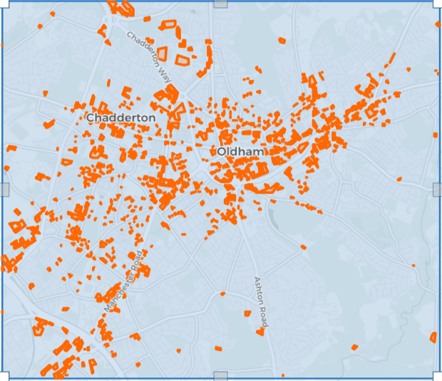
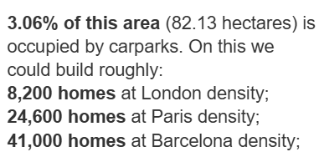
Oldham

Slide 26
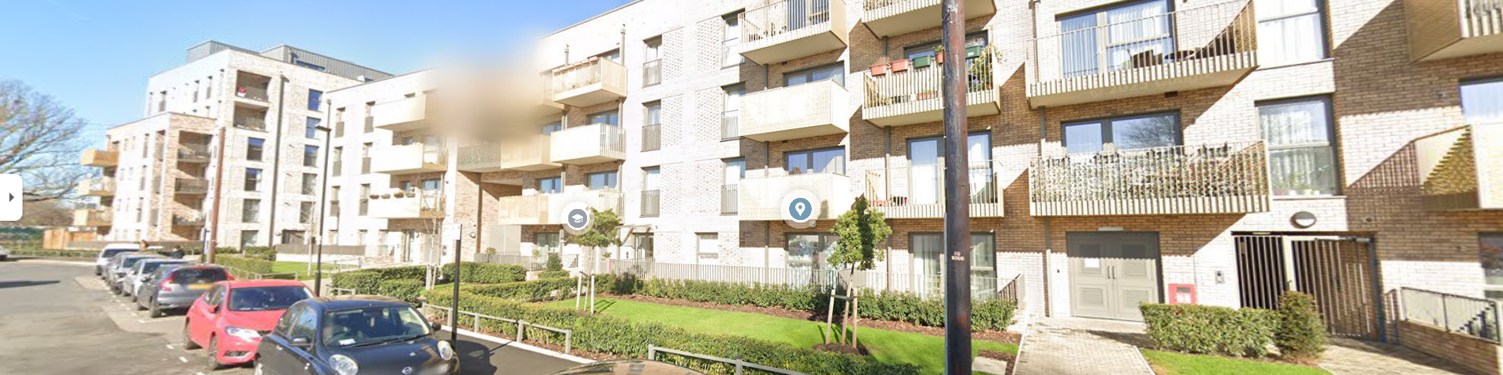
Create ‘low-car’ housing
The Assembly, car-free development Hounslow Outer London.
No or very little parking provided (car club / Blue Badge provided)

Slide 27
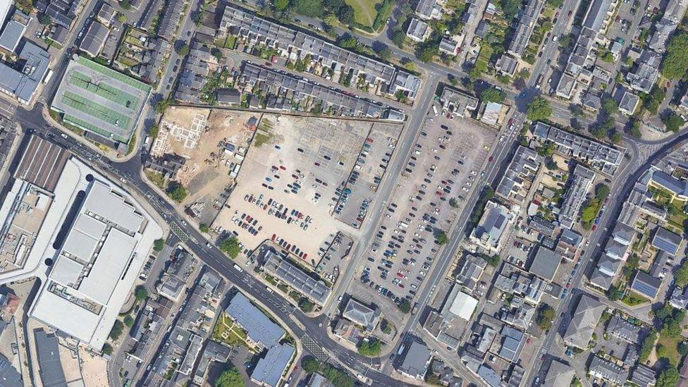
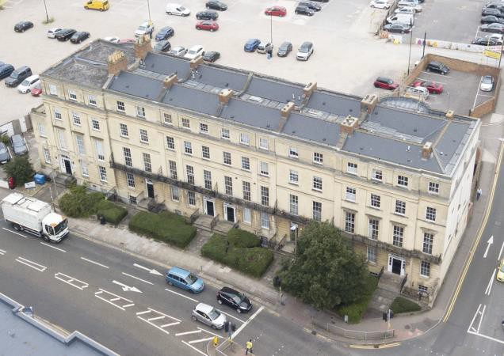
Site currently in use as a 1.4 hectare, ~ 500 space car park
The car park is situated within Cheltenham’s Central Conservation Area and Old Town Character Area, and borders
several listed buildings - such as Grade II Listed St Margaret’s Terrace (pictured above).

Slide 28

Car parks: a missed opportunity?
Knight Frank’s 2020 study identified 103,000 public and private surface car parks across the country
Land area of 20,000 hectares (7,555 hectares public sector)
Could yield 2.1 million homes (modest density assumption)
Often not well-used
(CPRE branches have proposed development of under-used car parks for housing, with limited success)
https://www.knightfrank.com/research/article/2020-07-15-government-owned-car-parks-could-hold-the-key-
to-110000-new-homes

Slide 29
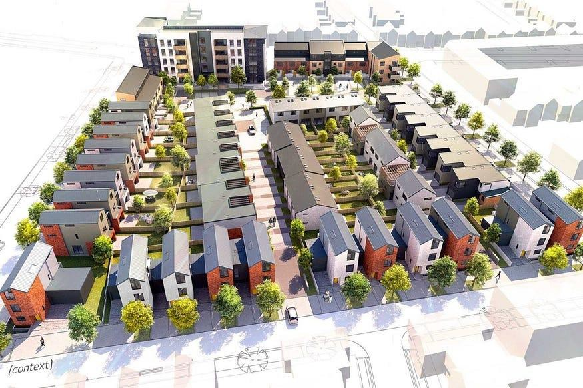


Density is important
We are consistently building at 30 to 40 dwellings per hectare (super low density)
But what does 100 dwellings per hectare look like?
https://medium.com/land-buildings-identity-and-values/can-great-design-help-solve-the-housing-crisis-c70a078d409d

Slide 30
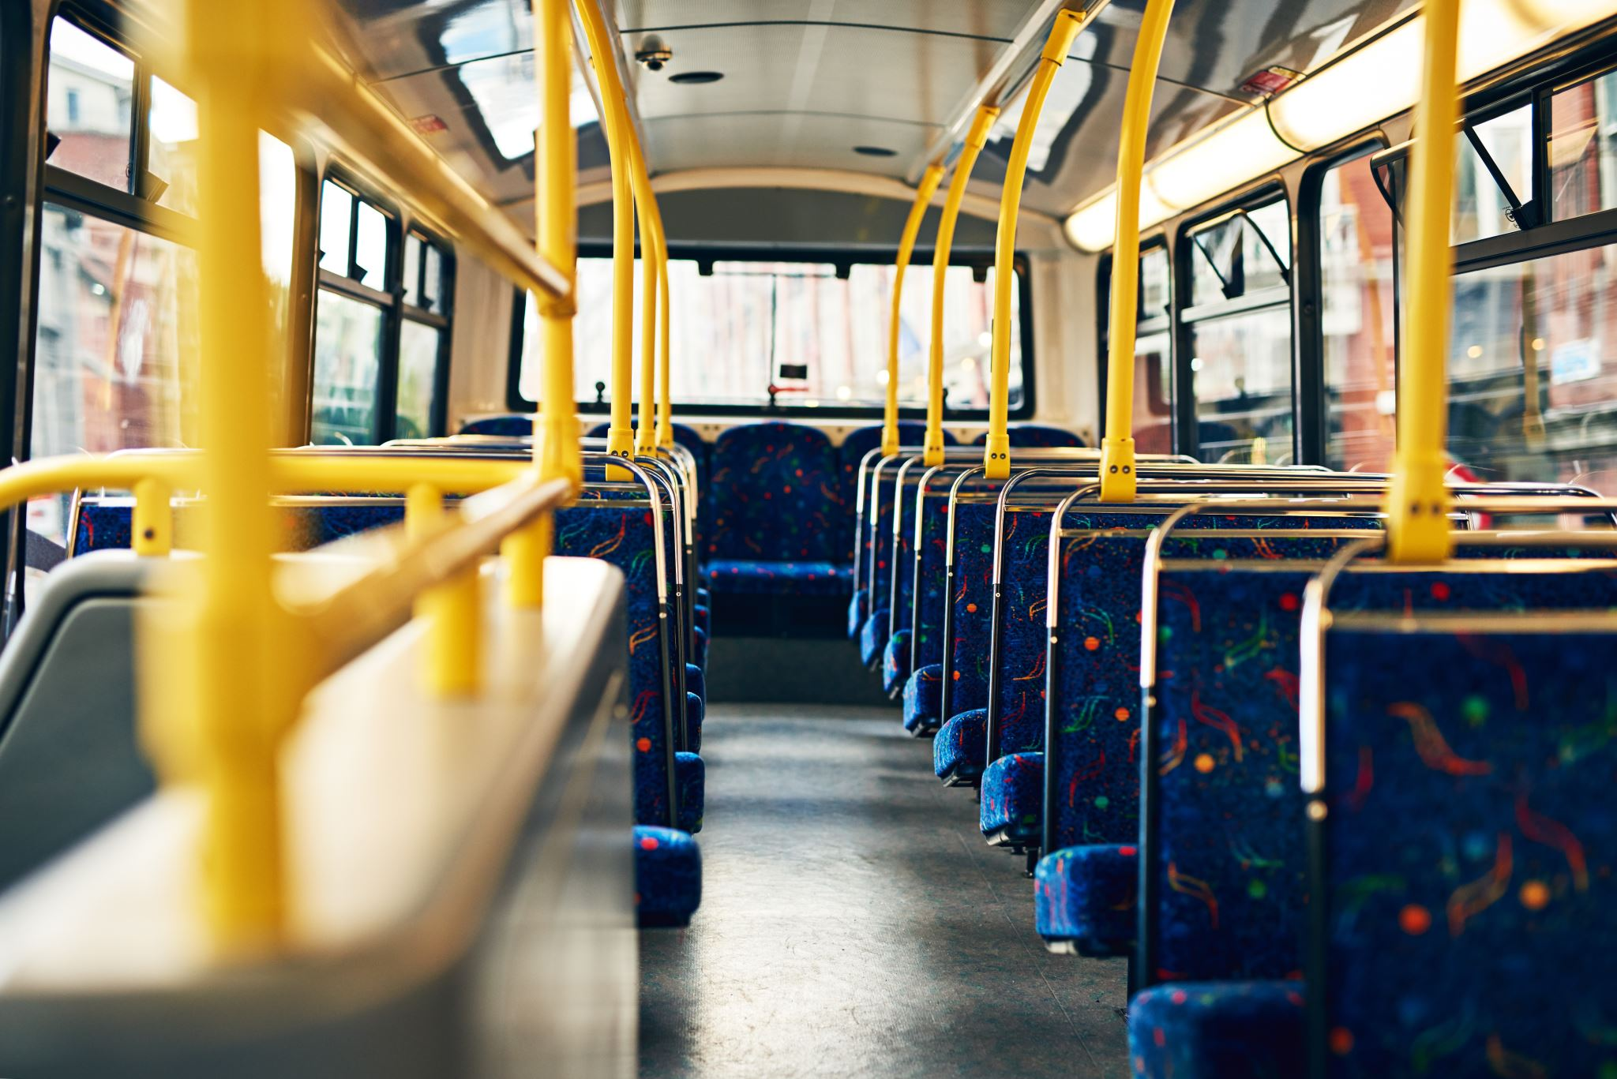

Slide 31
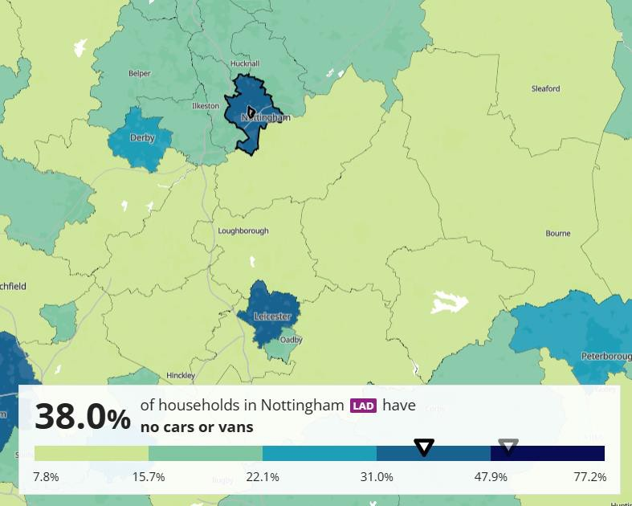
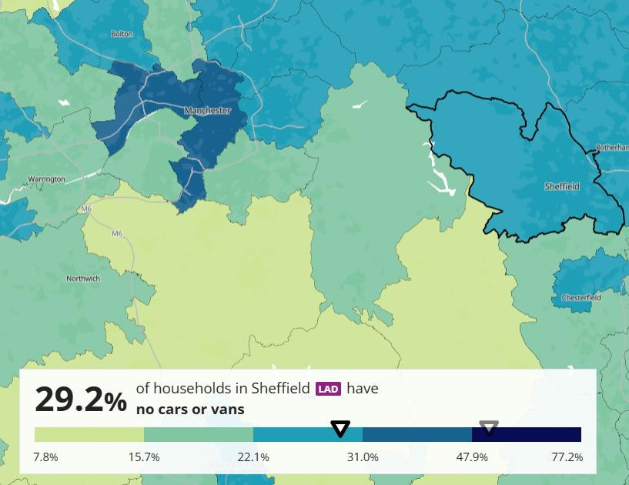


% households with no car or van
Equitable places
Nottingham
Sheffield
https://www.ons.gov.uk/census/maps/choropleth/housing/number-of-cars-or-vans/number-of-cars-3a/no-cars-or-vans-in-household

Slide 32

Appropriate Local Plan policies (a)
Local Plan underpinned by Sustainable Transport Plan (integrated transport and land-use planning) with mode shift targets to reduce car use in favour of public transport, walking & cycling
New housing must be planned in a sustainable location, recognising that making better use of space within existing towns, particularly surface cars parks, is demonstrably the most socially, environmentally and economically sustainable option
New housing must be planned at appropriate density to support public transport and local amenities – in other words at or above around 100 dwellings per hectare and certainly not below 60

Slide 33

Appropriate Local Plan policies (b)
Parking standards: Councils should adopt ‘car free’ or ‘car lite’ housing development policy restricting parking for private vehicles. Car club parking OK. Blue Badge parking YES.
Councils should seek to promote the redevelopment of surface car parks and ‘big box’ retail to make better use of space (this will also promote more sustainable travel), especially in town centres
FUNDAMENTAL: sustainable location i.e. in a location where residents do not have to use a car for the majority of trips
Less car-centric town centres: make them nicer!

Slide 34






Appropriate Local Plan policies (c)
Town centres Place-based, town-centre policies in Local Plans should be linked to reduction in car-parking and traffic, and a shift away from car-dependent retail on the town periphery.
Local Plans should support public transport, walking, cycling and wheeling by allocating space for bus transit, delivery hubs and walking and cycling infrastructure
Local Plans should provide clarity for developers, particularly on low car-parking standards, to ensure local authorities can lever investment into public transport, walking and cycling.

Slide 35

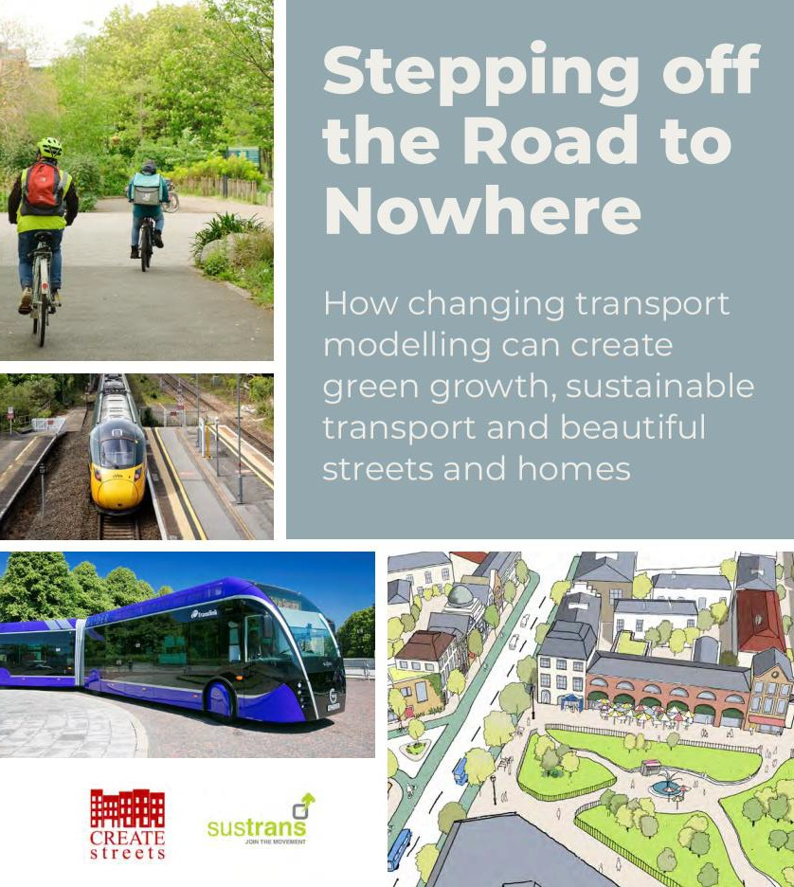
Clarity for developers
Clarity in Local Plan policies on expectations on how people will travel are essential to gaining value from development
“The spend on roads was reduced to just £2m, freeing up £23m to be spent on facilities for the whole community”

Slide 36


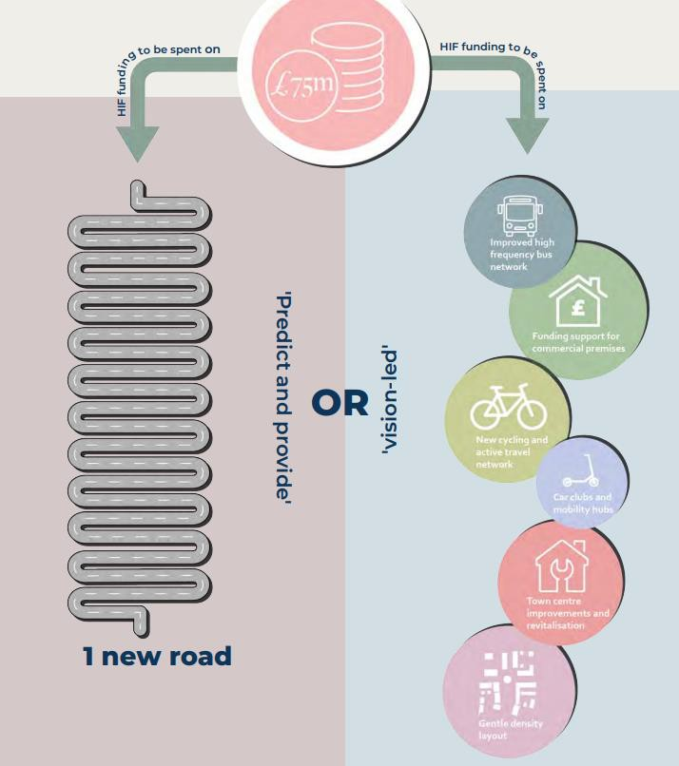
Predict and provide…. OR … ‘vision-led’
An important read…
https://www.sustrans.org.uk/media/13431/stepping-off-the-road-to-nowhere-report-sustrans-create-streets.pdf

Slide 37



Transport Strategy policies
Local Transport Plans MUST include strong residential and destination parking policy with the aim of delivering incremental mode shift i.e. from car trips to public transport/walking/wheeling/cycling. Backed up by mode shift targets.
Transport planners should work with planning, highways and parking teams to control availability and cost of car parking, including reducing and increasing charges / introducing a Workplace Parking Levy. Surplus income can be allocated to improve people’s travel choices e.g. funding concessionary fares.
Transport authorities should adopt bus franchising powers with a view to cross-subsidising profitable and non-profitable routes. They should consider using parking account surplus to fund bus infrastructure and concessions.
Transport, highways and parking teams should also work together to allocate a minimum of 25% of urban kerbside space, as well as excess road space and road lanes, for active travel, public transport and green infrastructure.

